Slide 1

U.S. 50/Hazel Avenue
Interchange Project
March 27, 2025

Slide 2
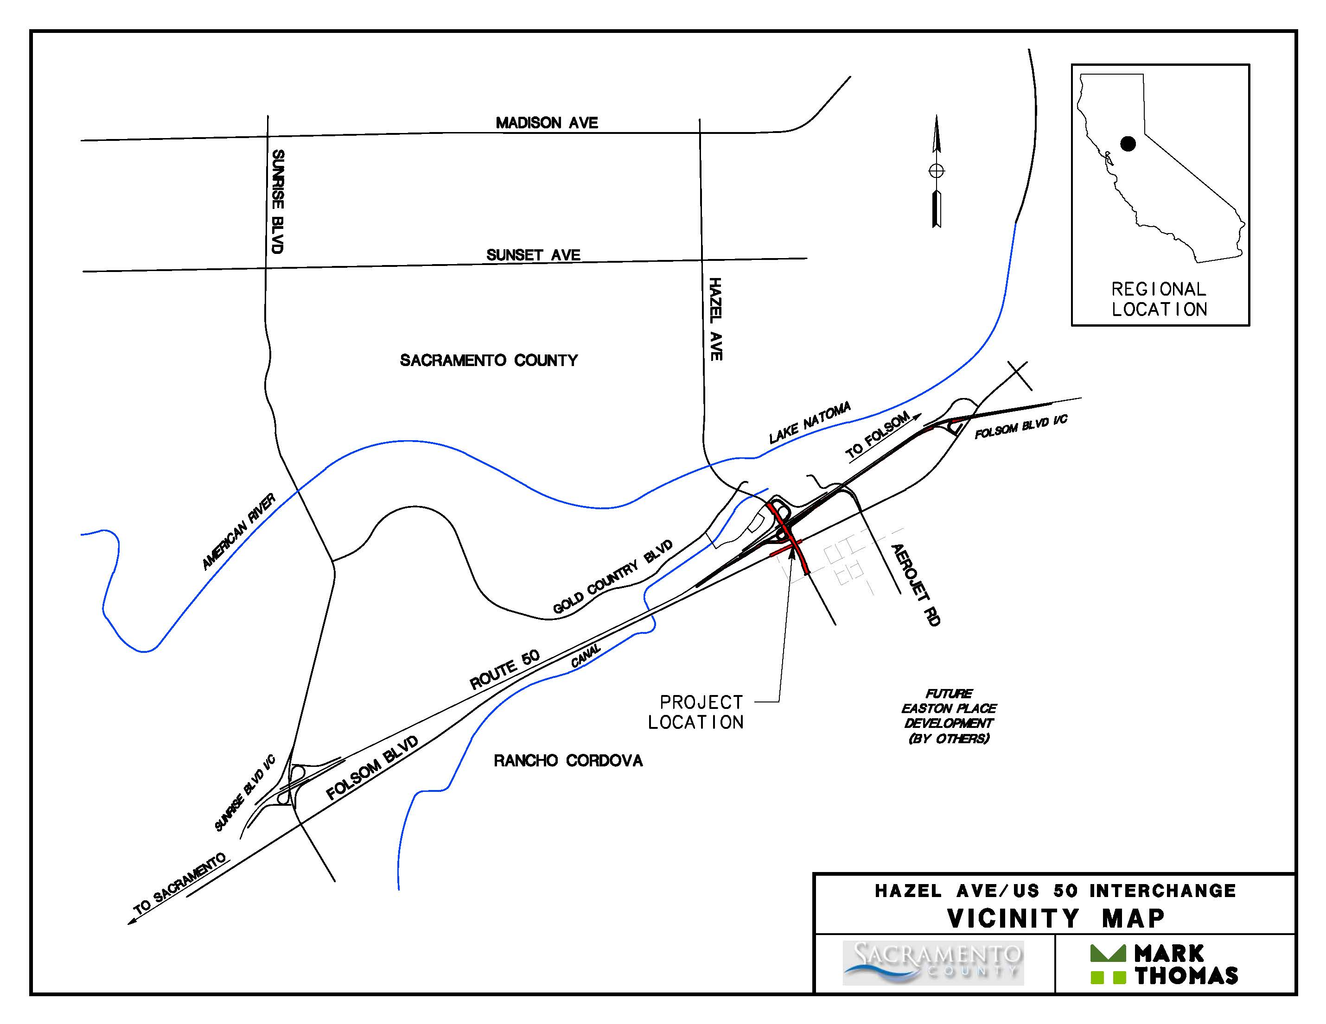
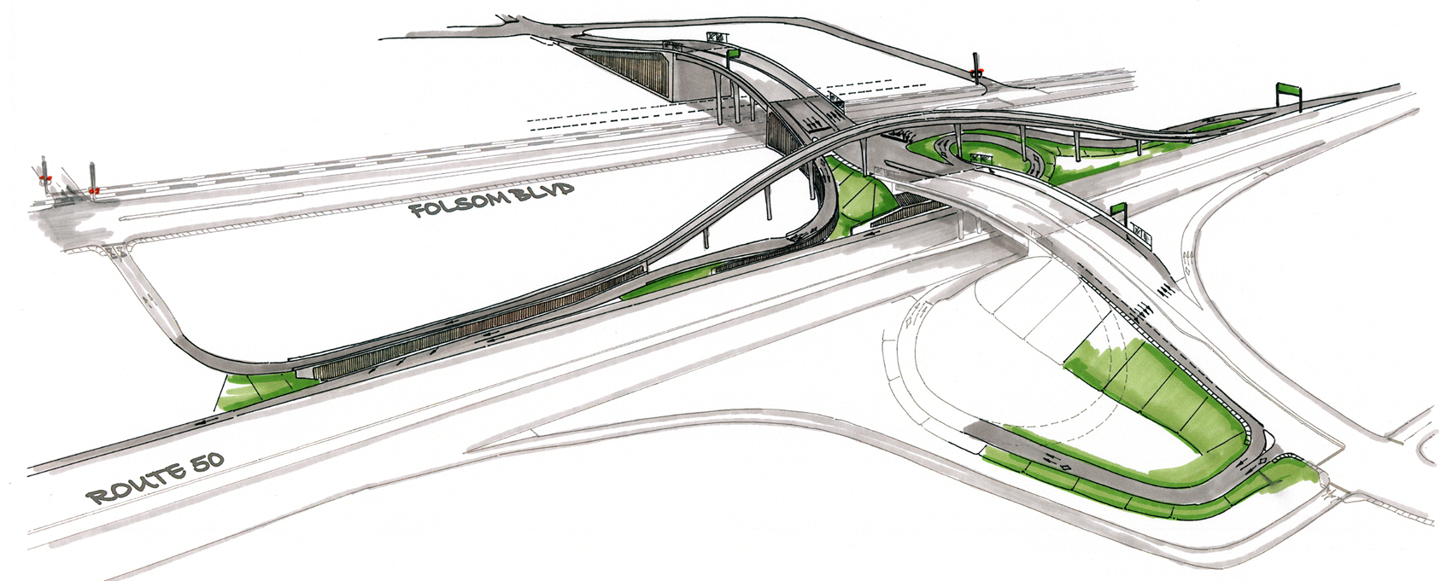
PROJECT BACKGROUND
Project Vicinity:
  Hazel Ave between Gold Country Blvd. and Atlanta St. and U.S. 50 from Hazel Ave. to Folsom Blvd.
Key Project Features:
  Construction of an overhead connection to Aerojet Rd. crossing over Hazel Ave. from Eastbound U.S. 50.
  Grade-separation of Hazel Ave. over Folsom Blvd.
  Construction of Logistics Center Way to connect to Folsom Blvd and relocation of the railroad crossing.
  Creation of a separated bike/pedestrian route along Hazel Ave. separated from vehicular traffic.

Slide 3
PROJECT BACKGROUND

Slide 4
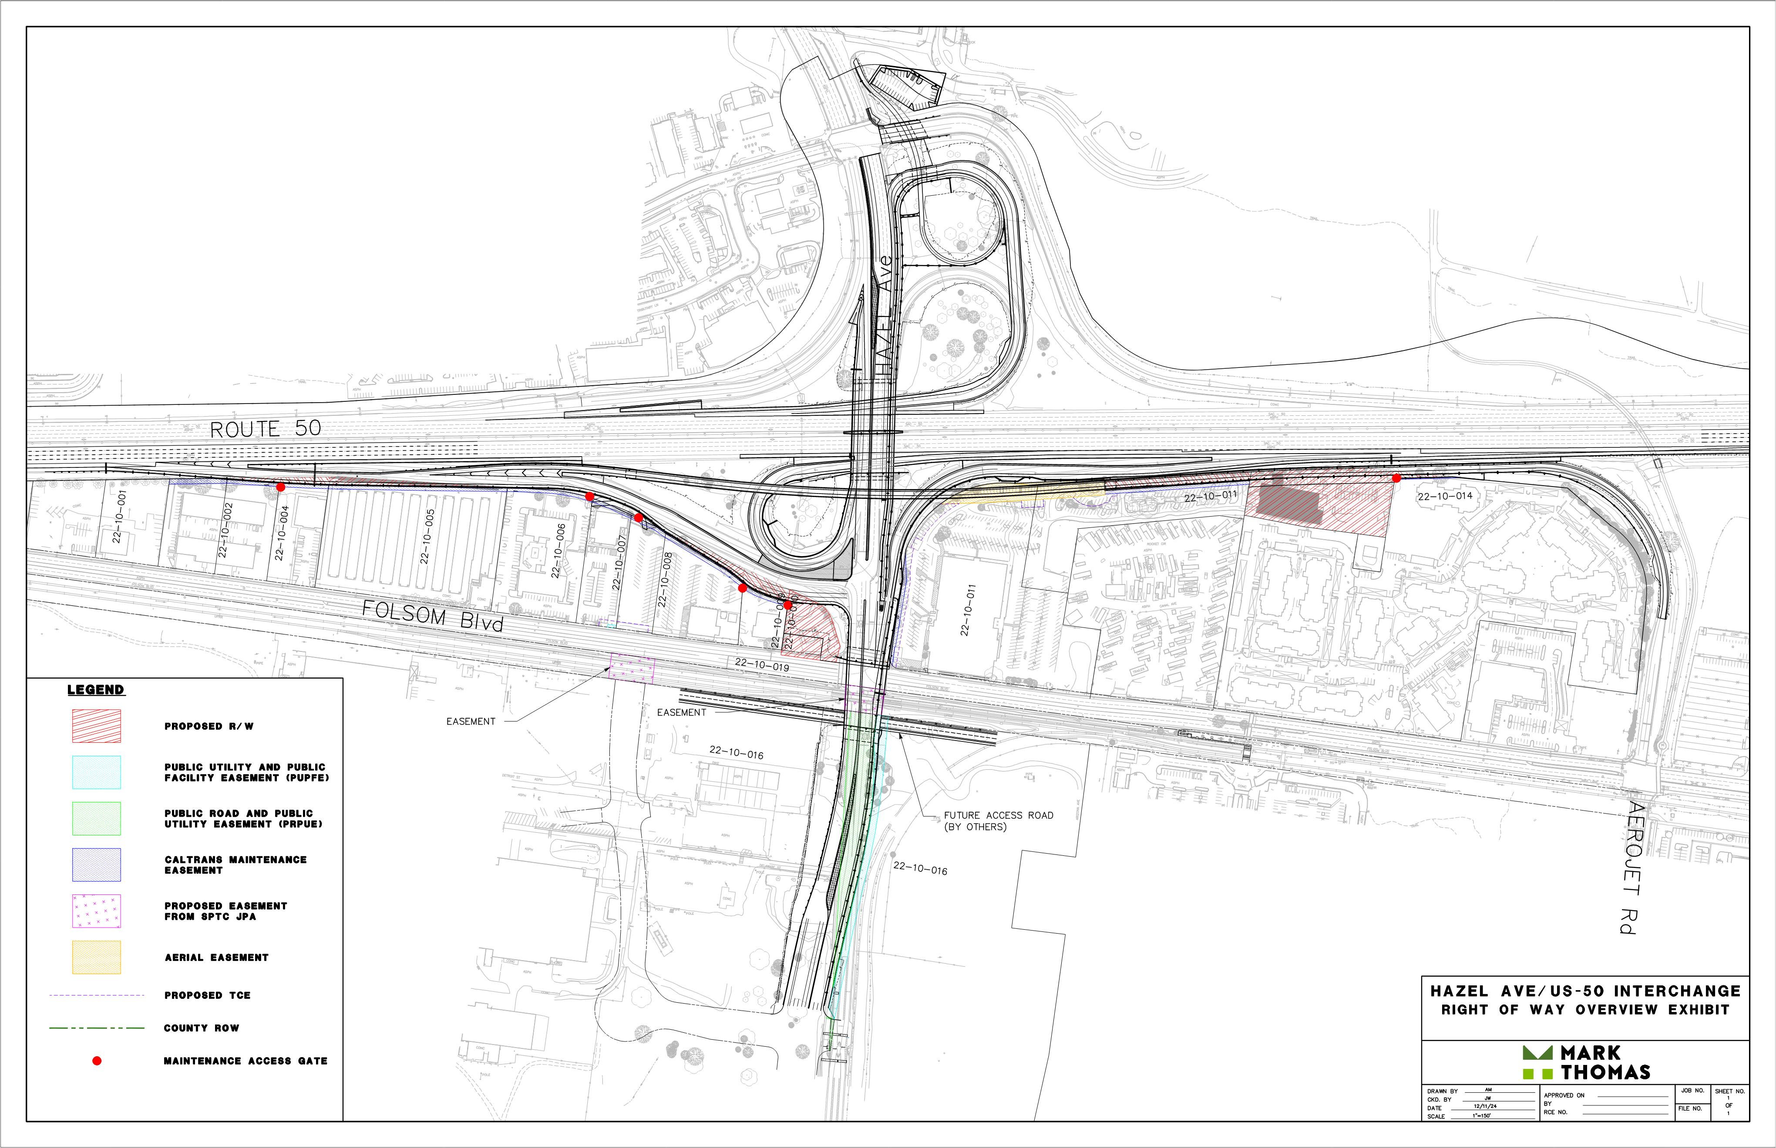
PROJECT STATUS
There are 13 parcels impacted by the improvements. 2 are full acquisitions (Chevron gas station and Cattleman’s restaurant).
The ROW acquisition phase is underway with the County’s offer for the full acquisitions out. The partial acquisitions are in appraisals.
Cooperative agreement with the City of Rancho Cordova to acquire right of way under the threat of eminent domain within the City limits

Slide 5
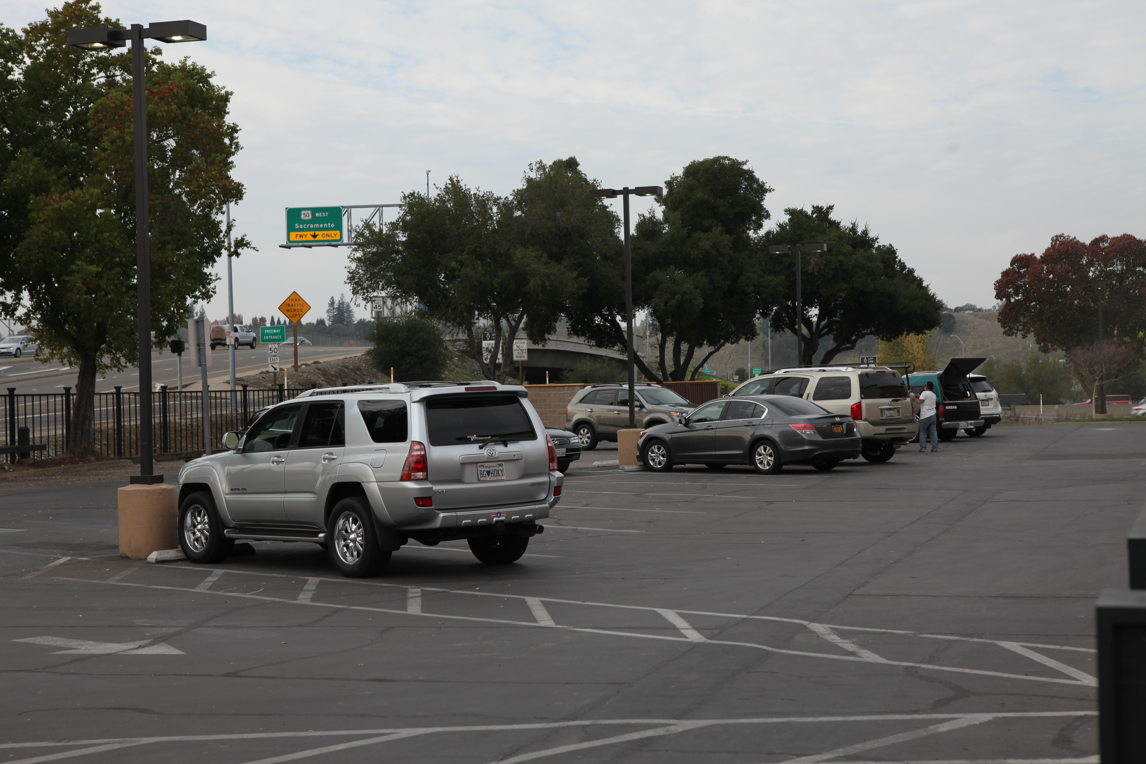
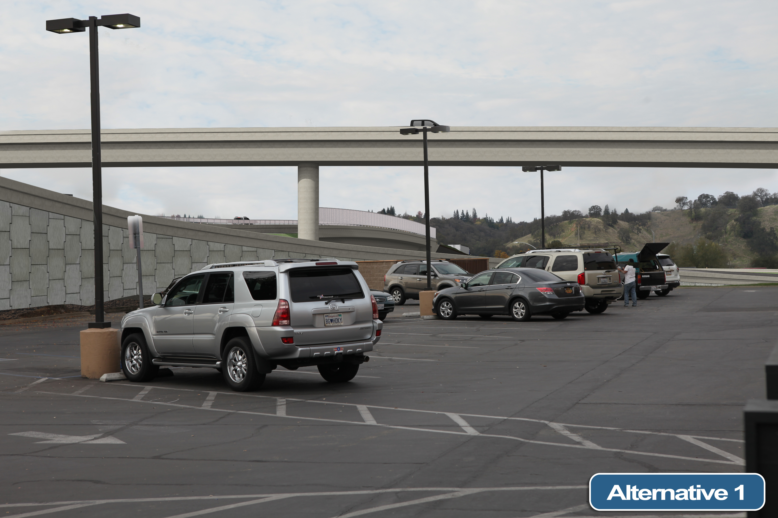
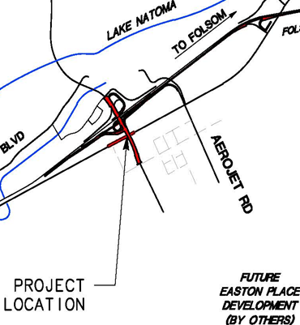

PROJECT STATUS
NIMBUS WINERY PARKING LOT
  The Aerojet Rd. overhead structure off-ramp will cross over the northern portion of the Nimbus Winery parking lot. Parking will be allowed below the structure to help mitigate impacts to the business.

Slide 6
PROJECT FUNDING
Revenue
Local Funds (Early phases are locally funded)
Measure A Sales Tax – Allocated | $ 10,958,000
Measure A Sales Tax – 3rd Decennial | $ 25,000,000
Developer Fee (SCTDF) | $ 40,042,000
Local Funds | $ 2,000,000
Project Cost
Construction Contract | $ 122,000,000
Engineering | $ 11,900,000
Construction Support | $ 9,000,000
ROW/ Land Acquisition | $ 17,100,000
Total Project Cost: | $ 160,000,000
Leveraged Funds (All in Construction phase)
SB1(LPP) | $ 15,000,000
State Fund (STIP) | $ 2,000,000
SACOG Revolving Match
Unfunded Need | $ 65,000,000
Total Revenue | $ 160,000,000

Slide 7
PROJECT SCHEDULE
Environmental
Final EIR Approval
September 2020
Prelim Engineering
2022 - 2024
Preliminary Engineering
Right of Way
Right of Way Acquisition
2023 - 2026
Final Design
Construction
2024 – 2026
Preparation of PS&E Package
Construction is anticipated to take two seasons and be open to the public by the end of 2029
2027 - 2029

Slide 8
U.S. 50/Hazel Avenue Interchange Project
Questions
QUESTIONS?

