Slide 1
Measure A – Capital Projects
March 27, 2025
Heather Yee

Slide 2
2004 Measure A Ordinance – Local Arterial Roads
Notes:
9 Major Corridors
Benefit of Measure A has been the ability to fund projects in the early phases of a project and flexible to fund the match needed for grants.
It has helped “tee” projects up to be competitive for grants

Slide 3
Projects Using Measure A Funding - Completed
Notes:
9 projects that have delivered since 2009

Slide 4
Projects Using Measure A Funding - Active
*Current expenditures
Total Project Costs incurred
Notes:
County primarily uses Measure A for the pre-construction phases of a project: PA&ED, PS&E, ROW. This tees projects up to be competitive for Construction funding.

Slide 5
Projects Using Measure A Funding - Active
Estimated Total Project Cost
Forecasted Measure A
Notes:
The projects that are in design phase, these projects still need $$ for construction
The project that are in construction, these are skewing higher than the 33% of MA used on a project

Slide 6
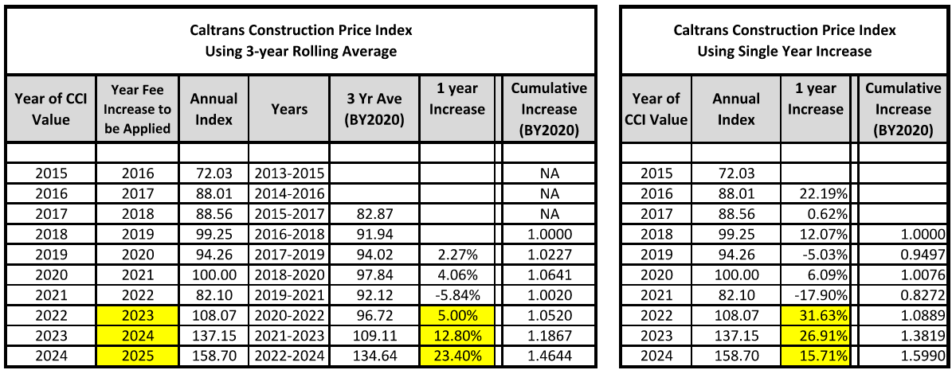
Caltrans Construction Cost Index
Sacramento County uses a 3 year rolling average to calculate the Sacramento County Transportation Development Fee (SCTDF)
Notes:
Why the increase in construction cost?
Market Trend in construction costs

Slide 7
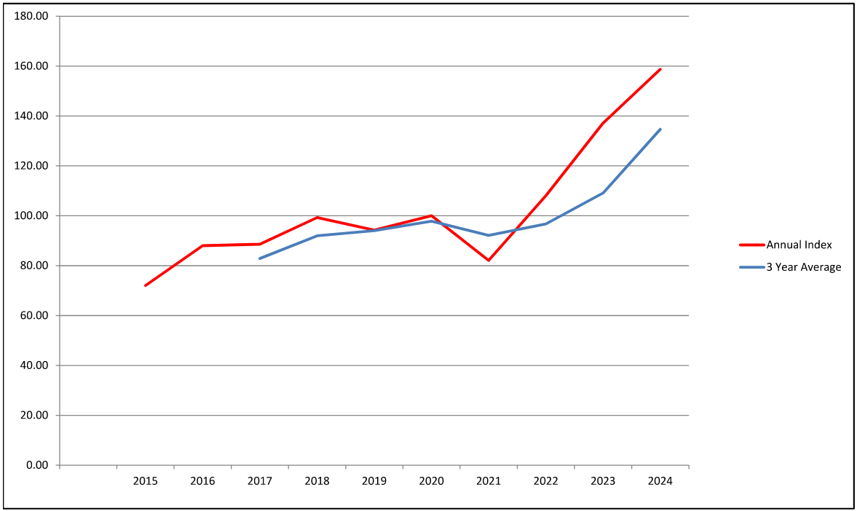
Caltrans Construction Cost Index
Sacramento County uses a 3 year rolling average to calculate the Sacramento County Transportation Development Fee (SCTDF) . This graph illustrates the single year vs. a 3-year average of the CCI

Slide 8
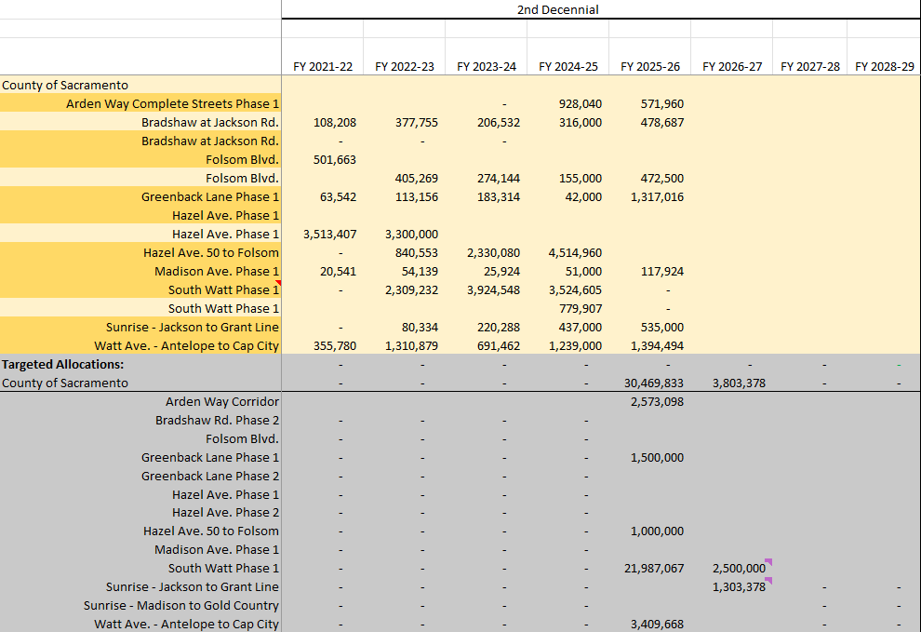
Measure A – Expenditure Plan
Notes:
County intends to contract for the $34,273,211 (remaining 2nd Decennial) in the FY26 Budget as an amendment to the existing contract.
Concern by STA and the ITOC is in the spend down of funds
This plan identifies how Sac County will accomplish the spend down.
There are 3 large, active projects in construction and there will not be delays as is often the case in pre-construction.

