Slide 1
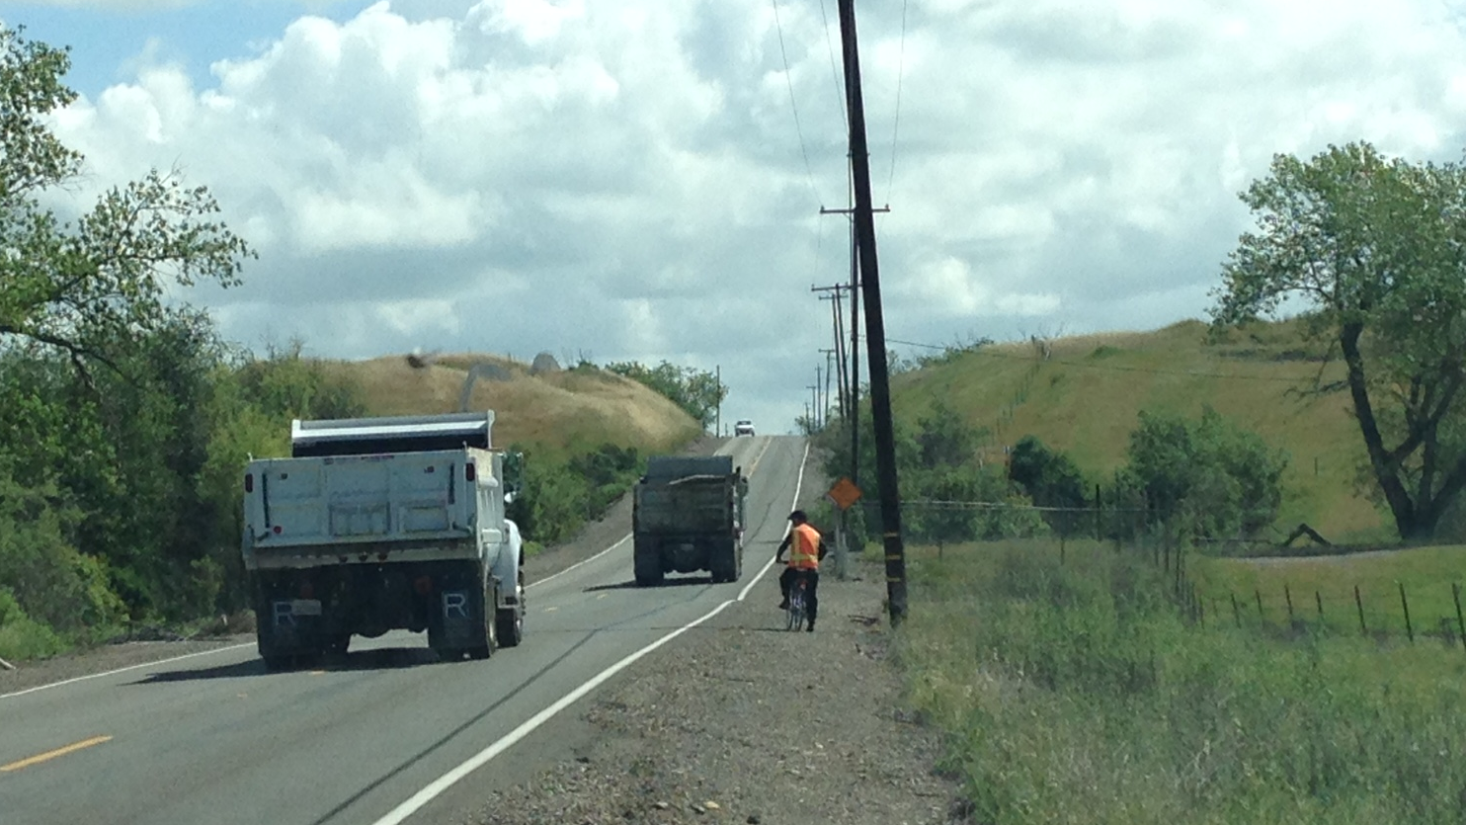
White Rock Road Safety and Congestion Relief Project
Local Partnership Program 2020
City of Rancho Cordova

Slide 2
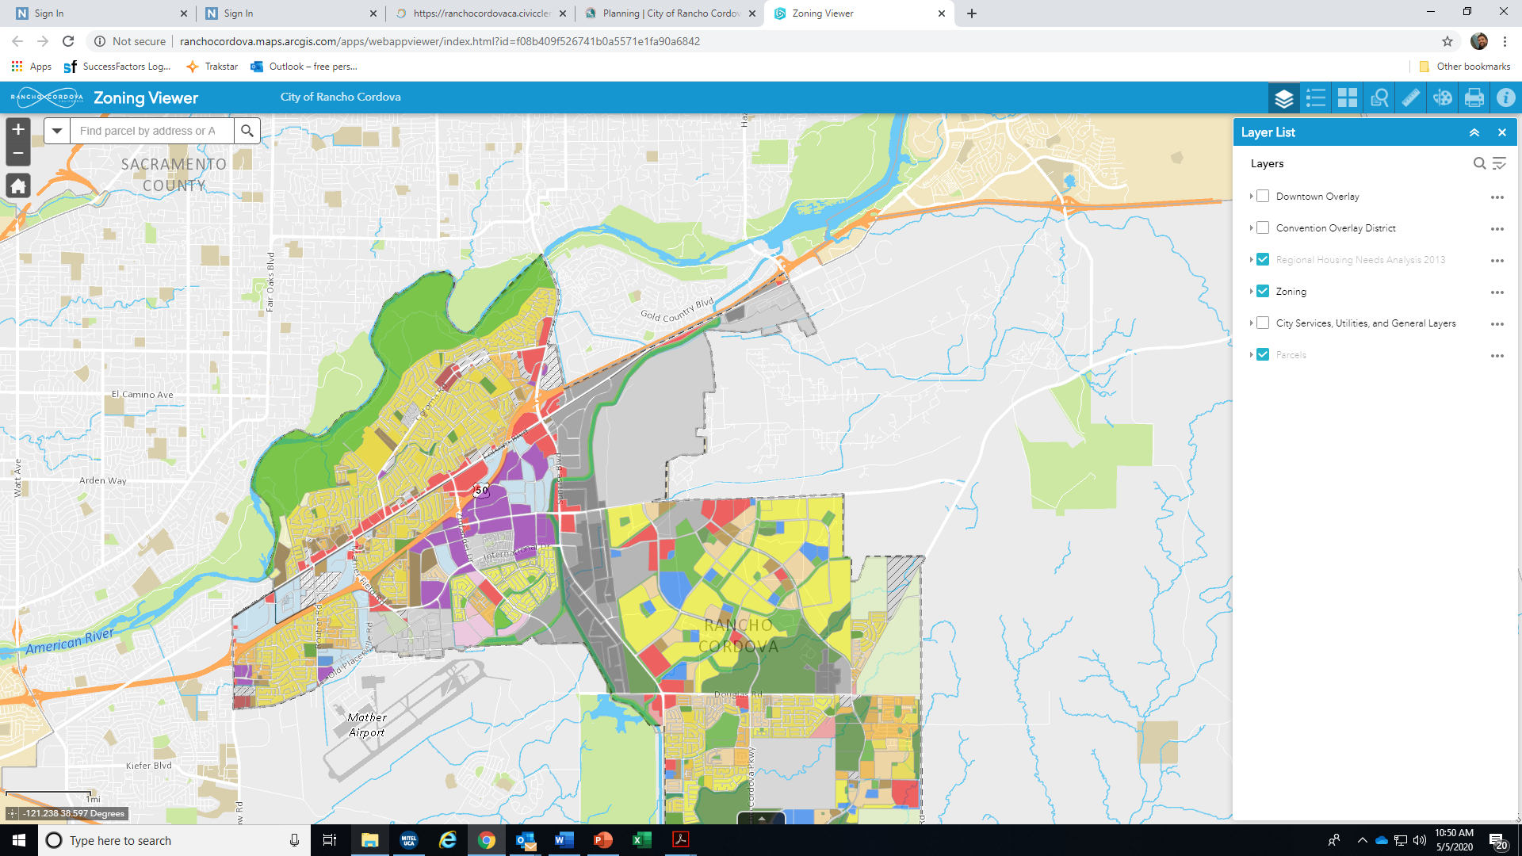
White Rock Road – Project Location
Growing Communities
Parallels US 50
One mile from 2nd largest job center with over 70,000 jobs
Growing communities to east
19,000 proposed homes in Rio Del Oro and Westborough
Includes low income housing, commercial and industrial
Westborough
White Rock Rd
70,000 +
Jobs
Rio Del Oro
Grant Line Rd

Slide 3
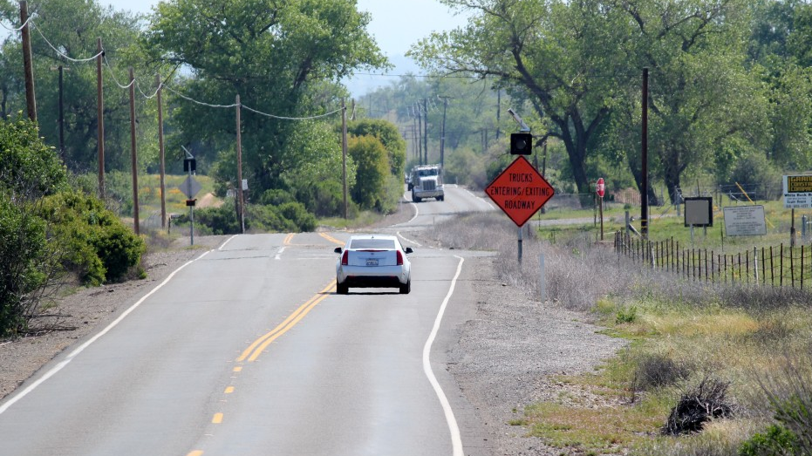
White Rock Road Existing conditions
Two-lane road with no shoulders
Blind curves. No opportunities for bike or pedestrian mobility
Crumbling road surface creates a dangerous and costly expense to drivers
Accidents and fatalities

Slide 4
Critical challenges facing White Rock Road
Lack of shoulders and blind turns cause safety concerns, accidents and fatalities
Inadequate infrastructure increases demand on US 50 which causes further congestion, greenhouse gas emissions and time delays reducing quality of life for residents
Inadequate roadway inhibits development of affordable housing adjacent to the road
Impediment to jobs housing balance, economic development and connected communities
No bicycle or pedestrian facilities

Slide 5
White Rock Road Opportunities
Rancho Cordova is home to a workforce of more than 70,000, the 2nd largest job center in the 6-county region
White rock road serves job creating businesses including high-tech, medicine, manufacturing and construction
19,000 housing units are proposed adjacent to White Rock Road which would help close the jobs to housing imbalance
Businesses select Rancho Cordova and the business park off White Rock Road due to quality of office buildings, central location, location above the flood plain and amenities in the city

Slide 6
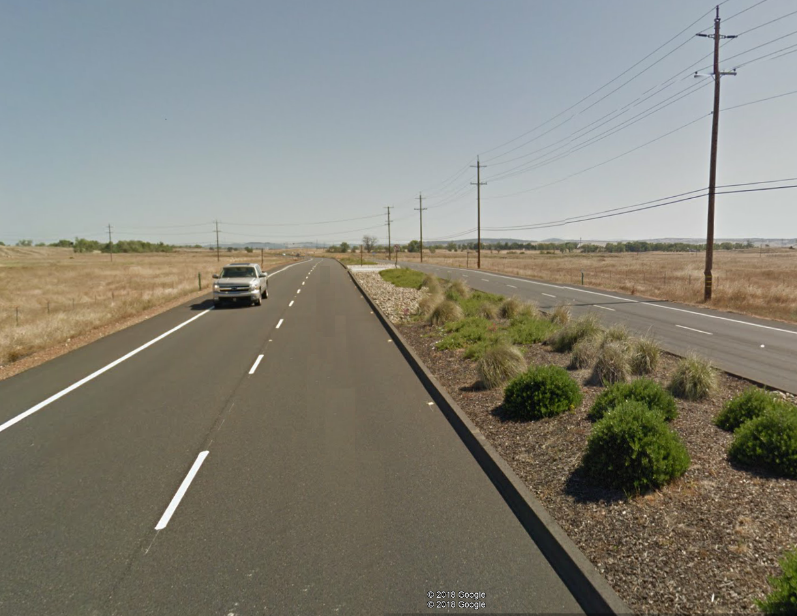
White Rock Road Improvements
Four-lanes
New signal at Rancho Cordova Parkway
Fiberoptic connection to the City’s traffic management center
Class II bicycle lanes
Raised median

Slide 7
Funding Request
Total project cost = $35 Million
LPP request = $13.25 Million
Matching Funds: $21.75 Million
  Federal funds = $8.5 Million
  Local funds = $13.25 Million

Slide 8

Project Status & Community Benefits
NEPA is complete
CEQA is complete
Shovel Ready!
Connect communities to 70,000 jobs and promote economic development
Improve safety and state of good repair
Regional partnership with public and private stakeholders
Alleviates regional congestion and reduces greenhouse gases
Parallel capacity for US 50. Critical part of Caltrans statewide Integrated Corridor Management Strategy
Natural extension of previous and current improvements to east
Elevate the quality of life in the region
THANK YOU!

