Slide 1
Fiscal Year 2024-25 Budget Presentation
May 9, 2024
Dustin Purinton, Accounting Manager

Slide 2
Title
Summary
The law requires the Authority adopts an annual budget.
Open Item – Appropriation Limit
Draft budget will be reviewed by the ITOC during the May 23rd meeting, prior to the final adoption by the Board on June 13th.

Slide 3
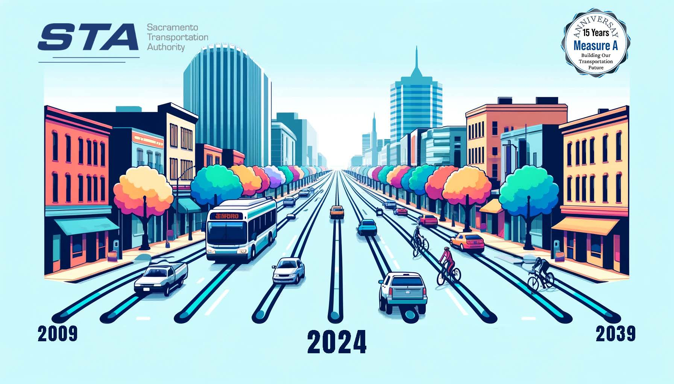
Title
Measure A 50% Milestone Budget to Actual
WE ARE HERE

Slide 4
Title
Measure A 50% Milestone Budget to Actual
Notes:
Sales Tax was originally projected to provide $4.7M. Sales taxes have a 6.6% growth rate over the ordinance. Note this is higher than it would have been without the Great Recession starting off Measure A.

Slide 5
Sustainability Over the Long Run
Funding Constricted CIP
Formulaic Allocation of Revenues
Special District Sales Tax
Population and
Per-Capita Spending
Stability
Focus on Paying Down Long-term Pension Liabilities

Slide 6
Title
Policy and Budget Updates
STA will contribute the 5 Year Amortization amount for the CalPERS Unfunded Accrued Liability (UAL).
Focus on Visuals
New charts have been added to simplify presentation.
Approximately $502,000 in savings based on current accelerated UAL payments over the 20-year repayment term.
Retirement Plan Funding Policy Update
Budget Simplification
Duplication of information in the budget has been removed reducing the page number from 110 to 100.
Strategic Planning Goals
Build Public Trust
Develop Great Relationships
Align Transportation Priorities with Funding

Slide 7
Title
Strategic Planning Goals
Be a good steward of taxpayer dollars.
Develop and maintain great relationships with elected officials, partner agencies, stakeholders, and regulatory authorities.
Build Public Trust
Assist partner agencies in maximizing existing funding to achieve their priorities.
Maintain financial stability and operate efficiently.
Be an effective guardian of taxpayer dollars.
Educate the public on the use of Measure A funds and SacMetro Freeway Service Patrol.
Develop Great Relationships
Align Transportation Priorities With Funding
Relationships are critical to navigating the complicated nature of transportation funding.
Be actively engaged in advocating for partner agencies transportation priorities.
Help position transportation priorities and needs with additional funding.

Slide 8
Title
Consolidated Revenue Changes FY 23-24 to FY 24-25

Slide 9
Title
Consolidated Appropriation Changes FY 23-24 to FY 24-25

Slide 10
Questions?

