Slide 1
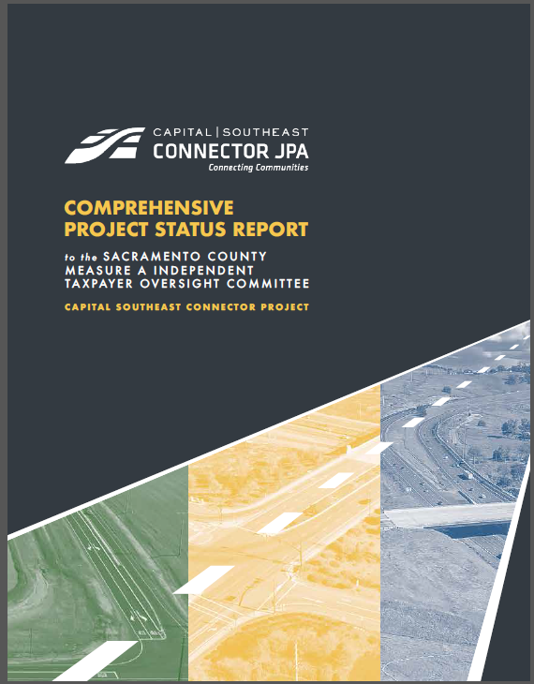
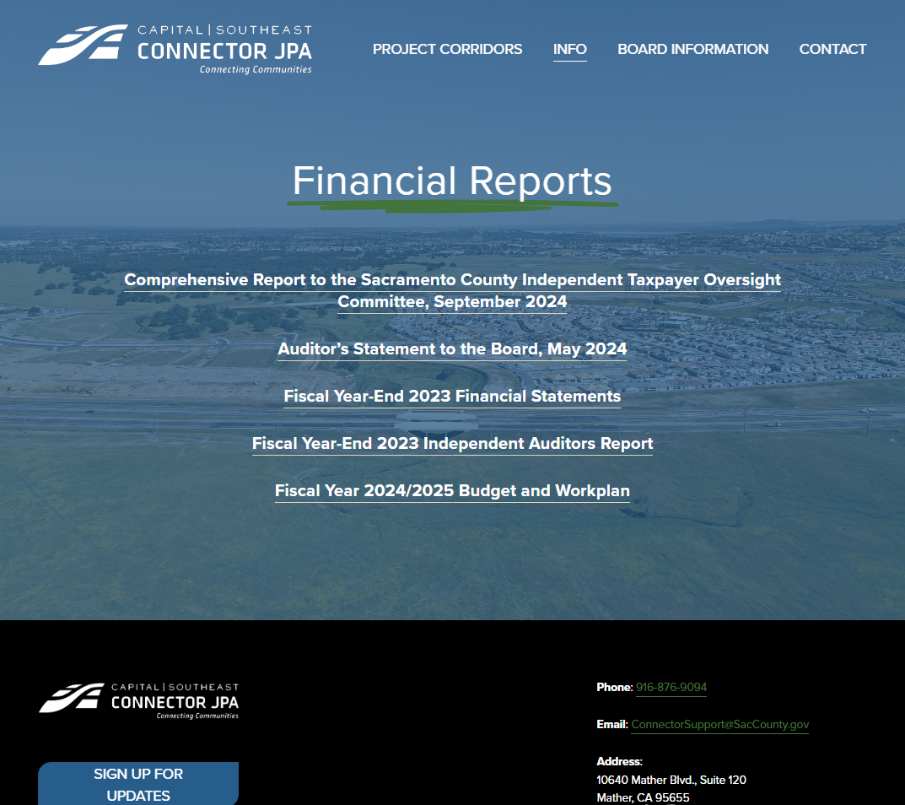
MEASURE A INDEPENDENT TAXPAYER OVERSIGHT COMMITTEE
DEREK MINNEMA
September 26, 2024

Slide 2
PROJECT OVERVIEW AND BENEFITS
PROJECT BENEFITS
REDUCES
traffic congestion and significantly improve flow on area roadways
ENHANCES
The link between key employment centers of Rancho Cordova and Folsom, and provides multimodal transportation options
DECREASES
harmful greenhouse gas emissions by decreasing vehicle hours traveled
34- mile corridor connects I-5, Hwy 99, SR 16 & Hwy 50
PROJECT OVERVIEW AND BENEFITS
2

Slide 3
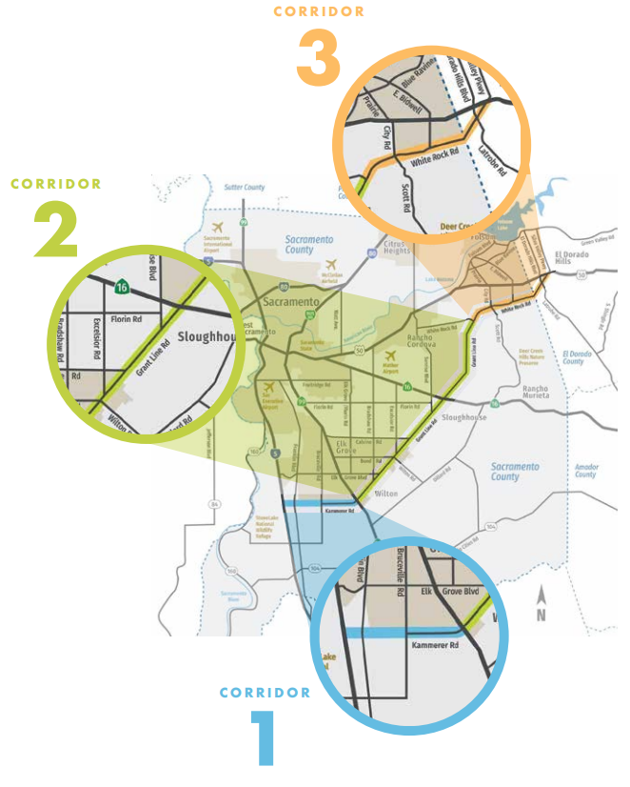
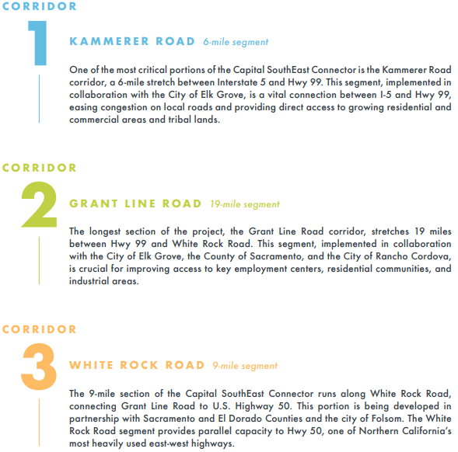
PROJECT CORRIDORS
3

Slide 4
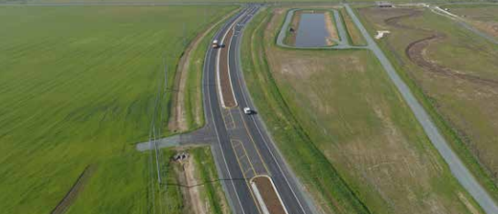
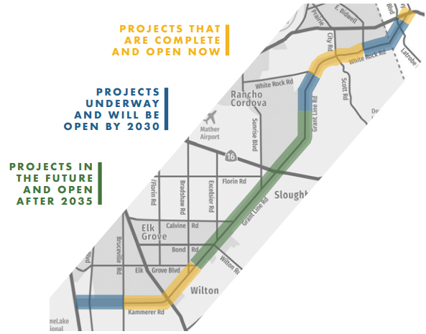
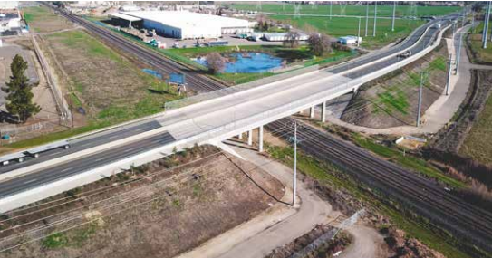
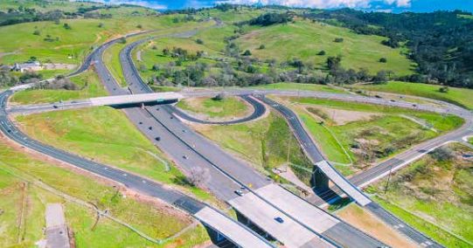
KAMMERER ROAD RECONSTRUCTION PROJECT completed in 2023
PROJECT STATUS
GRANT LINE ROAD/
UNION PACIFIC
OVERHEAD PROJECT completed in 2015
SILVA VALLEY PARKWAY INTERCHANGE PROJECT completed in 2015
PROJECT STATUS
3

Slide 5
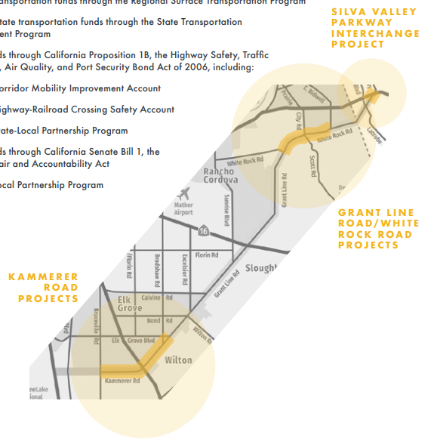
COMPLETED PROJECTS
2
Kammerer Road Reconstruction (Bruceville Road to Hwy 99) – Completed in 2023.
Hwy 99/Kammerer Road/Grant Line Road Interchange – Completed in 2009.
Grant Line Road/Union Pacific Railroad Overhead – Completed in 2015.
Grant Line Road Widening (Waterman Road to Bradshaw Road) – Completed in 2023.
White Rock Road Reconstruction (Grant Line Road to Prairie City Road) – Completed in 2018.
White Rock Road Expressway Phase 1 (Prairie City Road to East Bidwell Street) – Completed in 2023.
Scott Road Realignment – Completed in 2023.
Hwy 50/White Rock Road/Silva Valley Parkway Interchange – Completed in 2015.
highway interchanges completed
11
expressway miles completed
$230
MILLION
total cost of constructed improvements
COMPLETED PROJECTS
5

Slide 6
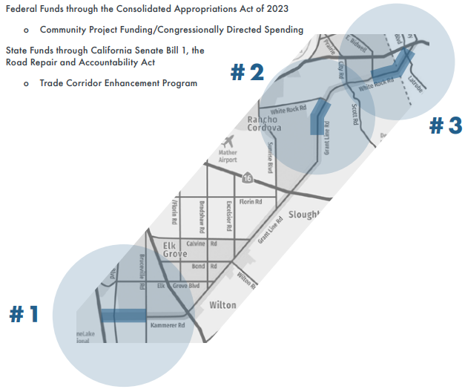
PROJECTS UNDERWAY – OPEN BY 2030
1. KAMMERER ROAD EXTENSION
(3 miles from I-5 to Bruceville Road) – Estimated cost $170 million, fully funded for design, but needs construction funding.
(3.5 miles from Chrysanthy Boulevard to White Rock Road) – Estimated cost $55 million, partially funded for construction.
(2.5 miles from East Bidwell Street to Latrobe Road) – Estimated cost $40 million, partially funded for design, construction funding needed.
9
total miles of current projects
2. GRANT LINE ROAD SAFETY & FREIGHT MOBILITY
$265
MILLION
3. WHITE ROCK ROAD EXPRESSWAY PHASE 2
total cost to construct improvements
PROJECTS UNDERWAY
4

Slide 7
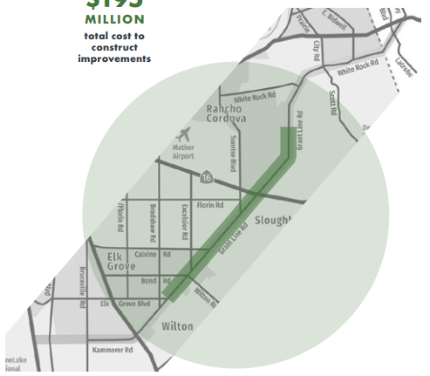
FUTURE PROJECTS
14 miles of Grant Line Road (from Bradshaw Rd to Douglas Rd expected completion after 2035
$195
MILLION
total cost to construct improvements
FUTURE PROJECTS
5

Slide 8
FUNDING GAP
CURRENT AND FUTURE CHALLENGES
Measure A and development fees are insufficient
Estimated $13M remaining Measure A allocation to project through 2039
SACOG’S 2016 DECISION
Excluded portions of the project from the Metropolitan Transportation Plan (MTP), limiting the project’s eligibility for certain state and federal transportation funds.
COMPETITION FOR STATE AND FEDERAL GRANTS
The project is competing with other major infrastructure projects across California and the U.S. for limited grant funding, making it difficult to secure the necessary funds.
$460
MILLION
needed to fully complete planned segments
CURRENT AND FUTURE CHALLENGES
10

Slide 9
PROJECT FUNDING
RECENT GRANT FUNDING SUCCESS
State
Local Partnership Program | $20 M
Trade Corridor Program | $3 M
Federal
Community Project Funding | $4 M
RAISE | $25M
Total | $52 M
PROJECT COST
Total Project Cost | $690 M
Completed Projects | $ 230 M
Future Need | $460 M
$460
MILLION
needed to fully complete planned segments
PROJECT FUNDING
6

Slide 10
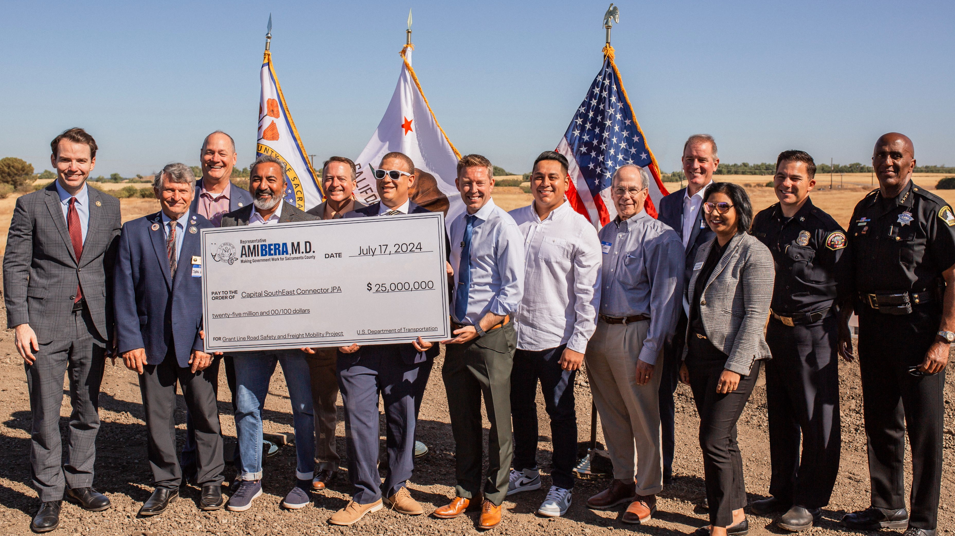
QUESTIONS?

