Slide 1
South Watt Avenue
Improvement Project
March 27, 2025

Slide 2
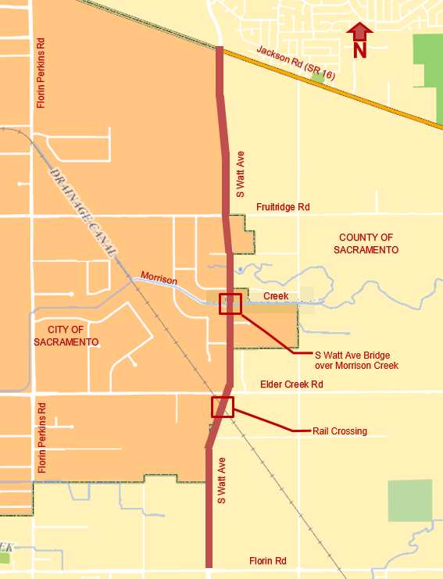
PROJECT BACKGROUND
Project Vicinity:
South Watt Avenue from Florin Road to Jackson Road (SR-16).
Background:
ROW acquisition of 80 parcels
Permits:
SSHCP
Army Corps
CDFW
CVRWQCB

Slide 3
PROJECT BACKGROUND
Key Project Features:
Widen South Watt Avenue to ultimate 6-lane width, striped as 4 lanes with buffered bike lanes.
Widen the existing California Central Traction Company (CCTC) railroad crossing.
Replacement of the bridge over Morrison Creek (CVFPB).

Slide 4
PROJECT BACKGROUND
COMPLETE STREET IMPROVEMENTS INCLUDING:
Landscaped medians
Class II buffered bike lanes (Class IV bike lanes in ultimate configuration)
Sidewalks & curb ramps
Street Lights
Traffic Signal Modifications
LID/Hydromodification Features (Basins)

Slide 5
PROJECT FUNDING
Revenue
Project Cost
Local Funds (Early phases are locally funded)
Financing District (FV-Bonds) | $ 2,535,000
Measure A Sales Tax | $ 35,025,000
Developer Fee (SCTDF) | $ 23,913,000
Local Funds | $ 2,000,000
Construction Contract | $ 65,600,000
Engineering | $ 9,630,000
Construction Support | $ 6,880,000
ROW/ Land Acquisition | $ 4,640,000
Total Project Cost: | $ 86,750,000
Leveraged Funds (All in Construction phase)
SB1(LPP) | $ 13,277,000
State Fund (STIP) | $ 10,000,000
SACOG Regional Funding Program
Total Revenue | $ 86,750,000

Slide 6
PROJECT STATUS/SCHEDULE
County Board of Supervisors approved award of the construction contract to Teichert Construction ($59,519,888) on January 7, 2025.
Construction began March 2025.
Construction completion in December 2026.

Slide 7
South Watt Avenue Improvement Project
QUESTIONS?

