Slide 1

South Watt Avenue
Improvements Project
Florin Road to Jackson Hwy
2020 LPP Department of Transportation Sacramento County

Slide 2
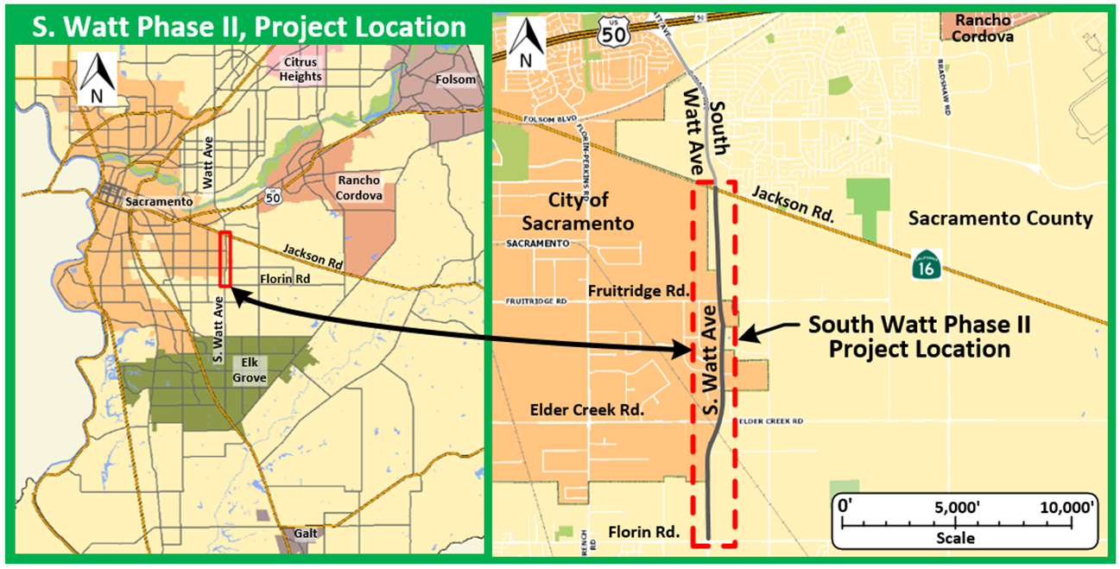
Location
2020 LPP Department of Transportation Sacramento County

Slide 3
Purpose and Need
OBJECTIVES
Provide necessary vehicular capacity and reduce existing congestion
Support bicycle, pedestrian, and transit modes
Improve safety on the corridor
SCOPE OF WORK
Improve 3 miles of South Watt Ave by adding two more lanes, a raised median with turn lanes, continuous buffered bike lanes and sidewalks
Upgrade 5 signalized intersections, replace a bridge, upgrade a RR crossing
2020 LPP Department of Transportation Sacramento County

Slide 4
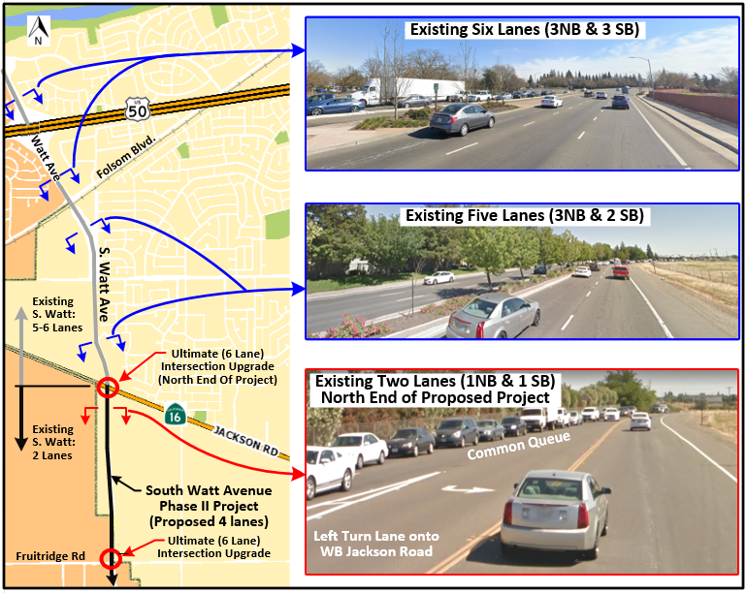
Building On Past Success For The Future
2020 LPP Department of Transportation Sacramento County

Slide 5
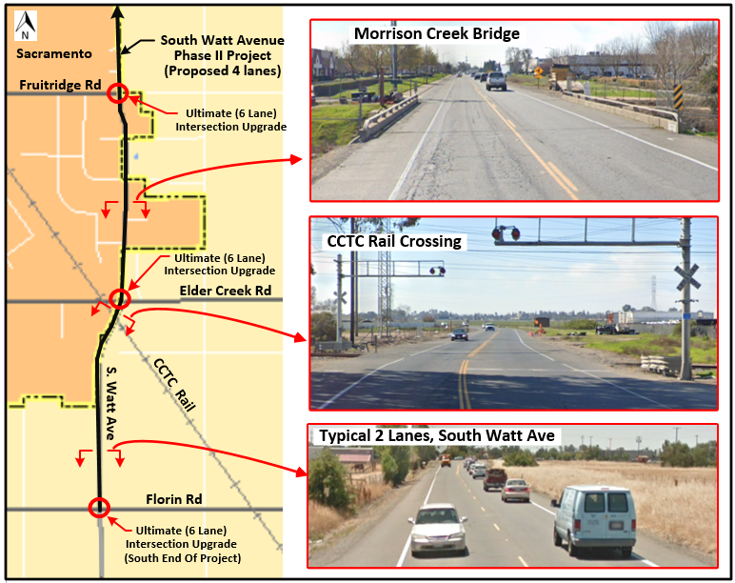
Building On Past Success For The Future
2020 LPP Department of Transportation Sacramento County

Slide 6
Evaluation Criteria
Life-Cycle Benefit/Cost Analysis: 6.6
Regional and community support: Power Inn Alliance, public/stakeholder support, vetted via CEQA clearance
Deliverability:
  CEQA already completed
  NEPA: April 2021
  ROW: May 2022
  CONSTRUCTION: April 2023
2020 LPP Department of Transportation Sacramento County

Slide 7
Evaluation Criteria/Improved Conditions
Leveraging $13.3M grant request with $21.8M of other funds
Air Quality improvements:
  5,330 ton annual reduction in ozone precursors and PM10 emissions
  9,000,000 annual reduction congested VMT
  146,000 annual reduction overall VMT
2020 LPP Department of Transportation Sacramento County

Slide 8
Evaluation Criteria/Improved Conditions
Furthers MTP/SCS Policy 4: “Build and maintain a safe, resilient, and multimodal transportation system”
  Safety improvements throughout corridor
  Improved LOS
  Parallel/alternate capacity to SR99
  Bike and pedestrian facilities/ADA upgrades
  Supports transit
  Improvements within AB 1550 Low-income community
2020 LPP Department of Transportation Sacramento County

Slide 9
Evaluation Criteria/Improved Conditions
Safety Benefits are needed
  99 collisions in last 5 years
  3 fatalities, 158 injuries
Improvements
  Medians
  Added lanes and turn lanes
  Upgrade signalized intersections
  Buffered bike lanes and sidewalks
  Street lighting
  RR crossing & Bridge railing upgrades
  Upgrade signage to current standards
2020 LPP Department of Transportation Sacramento County

Slide 10
Improved Conditions
Reduces congested VMT, overall VMT, and reduces emissions
Supports alternate mode choice
Improves safety for all modes
Improves LOS and system resiliency
Rehabilitates pavement
Supports affordable housing development in the area
Improves economic vitality businesses on the corridor
2020 LPP Department of Transportation Sacramento County

Slide 11
Questions?

Slide 12
Elverta Road Improvement Project Dutch Haven Blvd. to Watt Ave.
2020 LPP Department of Transportation Sacramento County

Slide 13
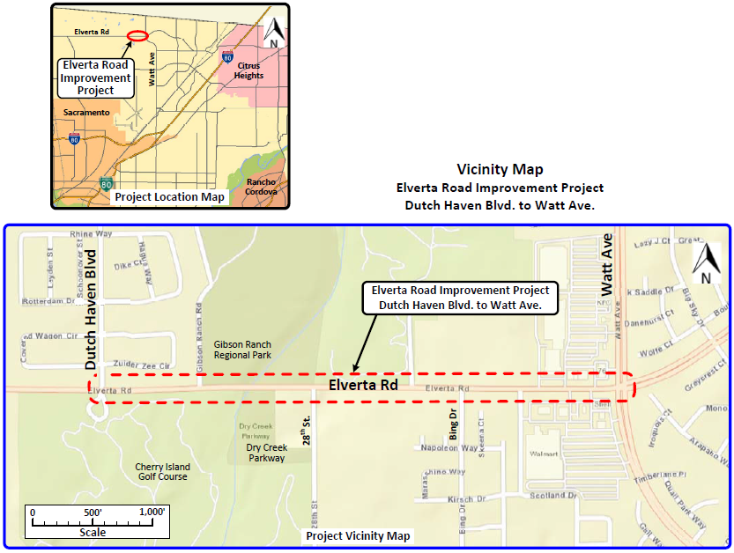
Location
2020 LPP Department of Transportation Sacramento County

Slide 14
Purpose and Need
OBJECTIVES
Provide necessary vehicular capacity and reduce existing congestion
Improve safety on the corridor
Support alternate modes
SCOPE OF WORK
Improve 0.9 miles of Elverta Road by adding two lanes, a raised median with turn lanes, Class-II bike lanes
Replace Dry Creek Bridge for capacity & safety
  Add separate equestrian & pedestrian facilities
Upgrade signalized intersection at 28th Street
2020 LPP Department of Transportation Sacramento County

Slide 15
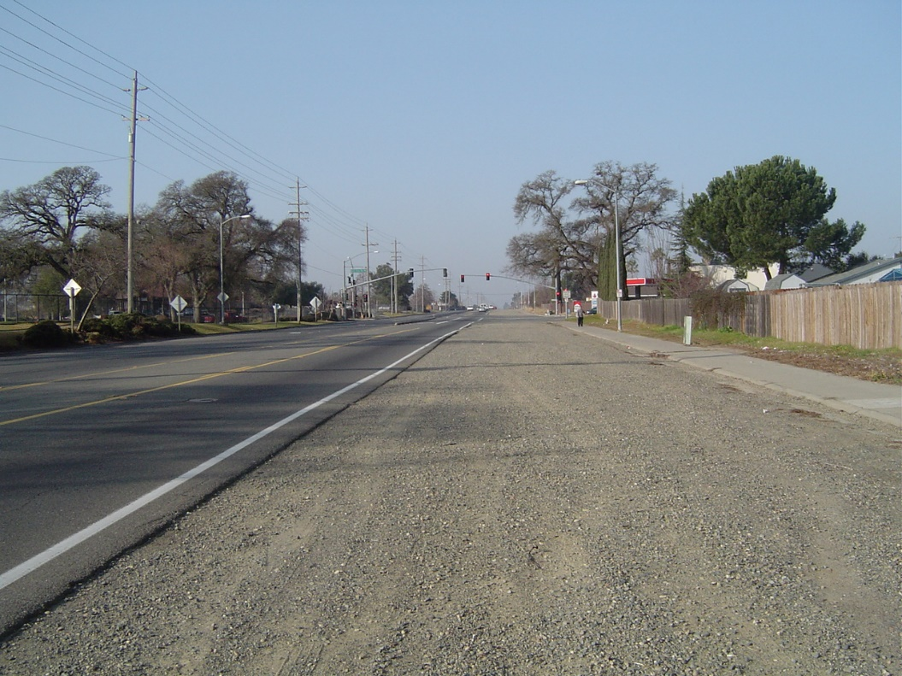
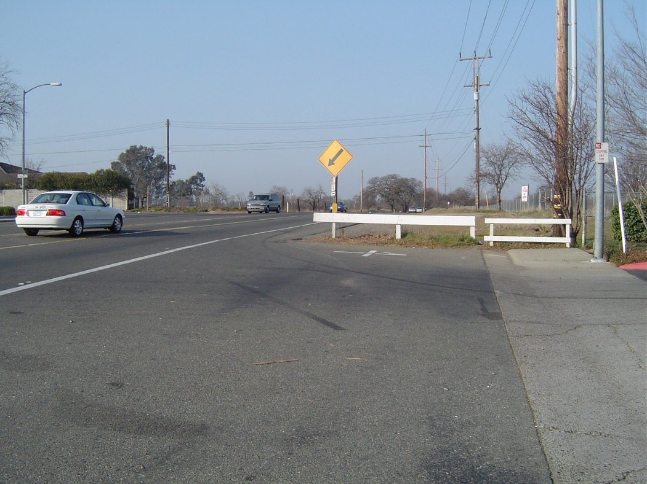
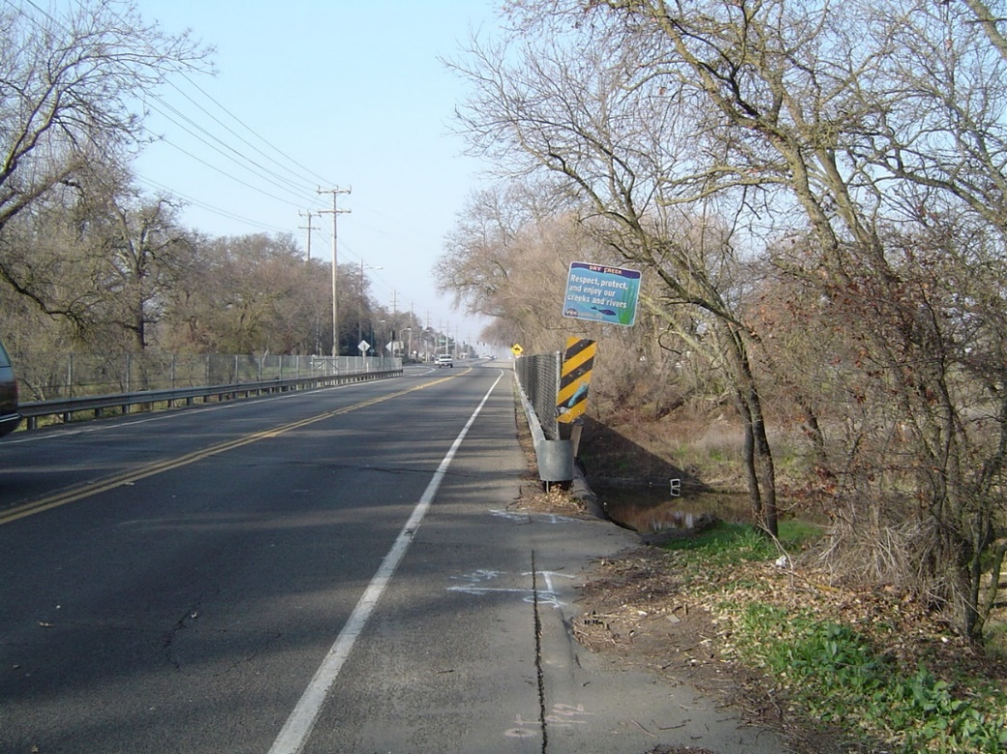
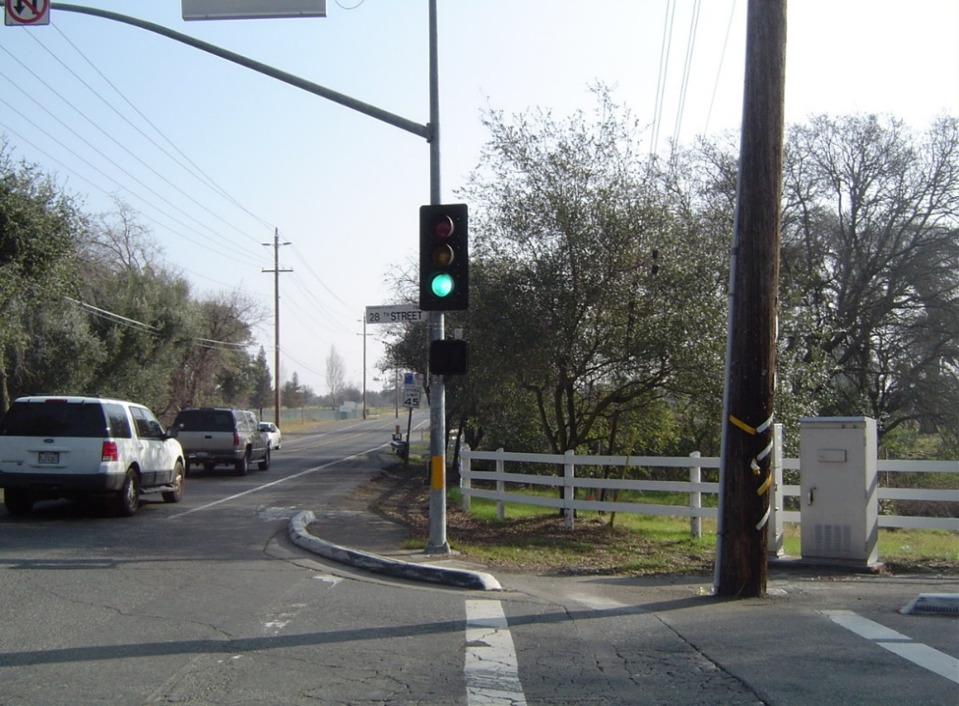
Existing Features
West End – Unpaved lane
East End – Urban/Rural Transition
Dry Creek Bridge
Intersection
2020 LPP Department of Transportation Sacramento County

Slide 16
Improved Roadway
2020 LPP Department of Transportation Sacramento County

Slide 17
Evaluation Criteria
Regional and community support: Public and stakeholder support, vetted via CEQA/NEPA clearance
Deliverability:
  CEQA/NEPA already completed
  ROW: November 2021
  CONSTRUCTION: April 2022
Leveraging: $5.5M grant request with $12.6M of other funds
2020 LPP Department of Transportation Sacramento County

Slide 18
Evaluation Criteria/Improved Conditions
Air Quality improvements:
  54 ton annual reduction in ozone precursors and PM10 emissions
  113,500 annual reduction overall VMT
2020 LPP Department of Transportation Sacramento County

Slide 19
Evaluation Criteria/Improved Conditions
Furthers MTP/SCS Policy 4: “Build and maintain a safe, resilient, and multimodal transportation system”
  Traffic safety improvements
  Improved LOS
  Bike, equestrian, pedestrian and ADA upgrades
  East half of project within an AB 1550 Low-income community
2020 LPP Department of Transportation Sacramento County

Slide 20
Evaluation Criteria/Improved Conditions
Safety Benefits are needed
  38 collisions in last 5 years
  2 involve bicyclists
Improvements
  Medians
  Added lanes and turn lanes
  Class II bike lanes
  Bridge replacement/widening
    Above 100 year floodplain
    Pedestrian and equestrian facilities
  Upgraded signalized intersection
2020 LPP Department of Transportation Sacramento County

Slide 21
Improved Conditions
Reduces VMT and reduces emissions
Improves bike lanes and ADA facilities
Improves LOS and system resiliency
Improves traffic safety
Reduces roadway flooding
Rehabilitates pavement
Supports affordable housing development in the area
2020 LPP Department of Transportation Sacramento County

Slide 22
Questions?

