Slide 1
Sacramento Transportation Authority
Market Update and Refunding Analysis
Presented by PFM Financial Advisors LLC
March 9, 2023
PFM Financial Advisors LLC
44 Montgomery Street
3rd Floor
San Francisco, CA 94104
415.982.5544

Slide 2
Table of Contents
Market Update
Overview of Debt Profile
Potential Swap Refunding
Next Steps
Appendix

Slide 3
1. Market Update

Slide 4
Tax Exempt Yield Curve
Inflationary pressure and the Federal Open Market Committee (FOMC) rate hikes increased interest rates over the last year:
  Tax exempt rates are up 222 basis points (bps) on the short end of the curve
  Long-term rates are up 164 bps

Slide 5
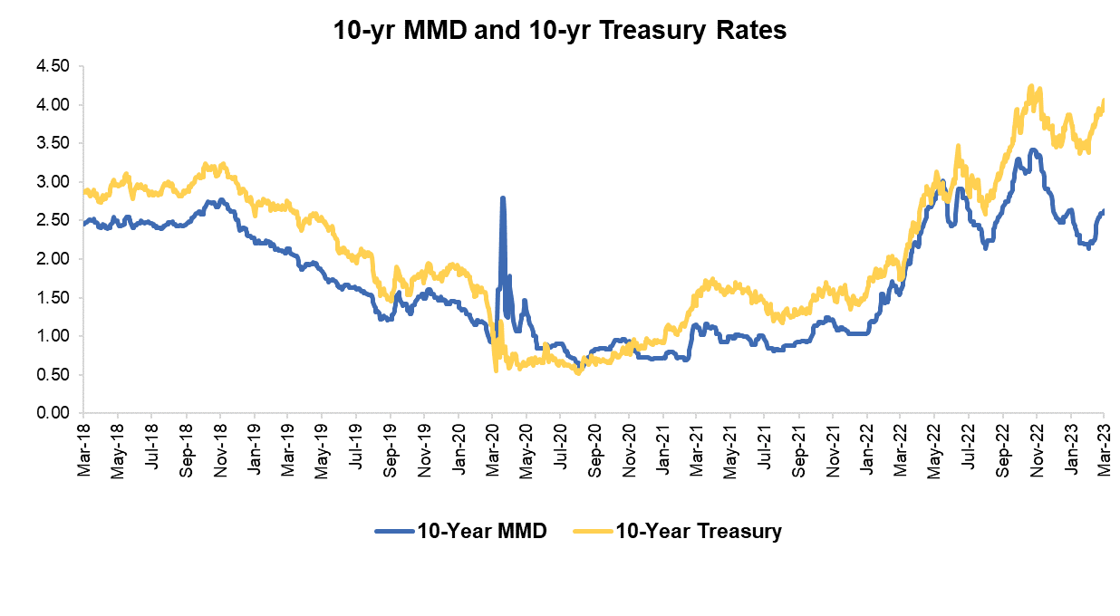
10-Year Interest Rates – Taxable & Tax Exempt
Taxable rates have increased faster than tax exempt rates
    Increased taxable rates decreases the cost to terminate the interest rate swaps
Simultaneously, STA can issue tax-exempt fixed rate bonds to replace the swaps and variable rate bonds
  Tax-exempt rates are relatively attractive compared to taxable rates

Slide 6
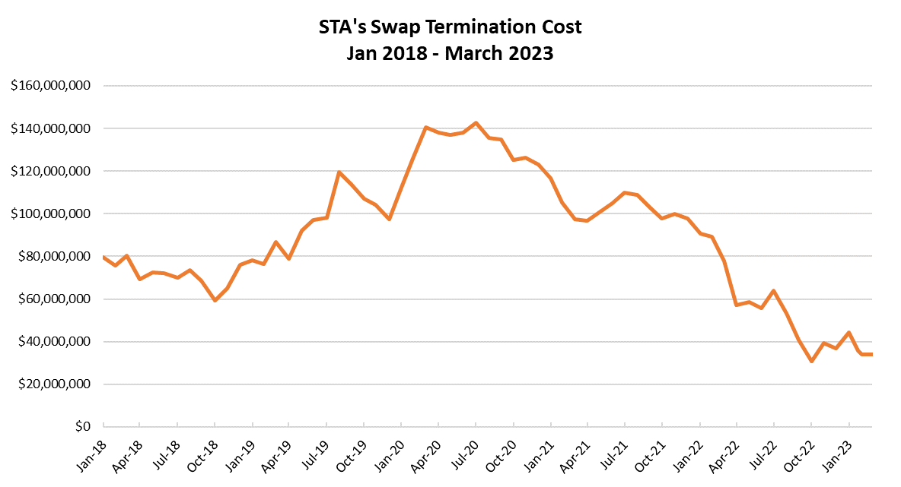
Swap Termination Costs Have Decreased in Recent Months
The cost to terminate STA’s interest rate swaps is currently near the low-point compared to the last five years
  Termination costs reached $140 million during the low-rate period of the pandemic and are now approximately $34 million
Current Termination cost = $34.0M

Slide 7
2. Overview of Debt Profile

Slide 8
Current Debt Portfolio
STA has outstanding debt in the par amount of $342.5 million
The Authority’s three swaps have a market valuation of ($34.01 million)
    None of the swaps have a collateral posting requirement and all swaps have performed as anticipated

Slide 9
Total Cost on Interest Rate Swap and Bonds
STA’s all-in cost of capital on the interest rate swaps is 4.06%, including all ancillary fees
Total Cost of Interest Rate Swap
STA Pays
Swap Fixed Rate | 3.71%
Fees to Remarketing Agents | 0.06%
Fees to Liquidity Providers | 0.37%
Positive STA Bond/Swap Differential | (0.10%)
All in Cost: | 4.06%

Slide 10
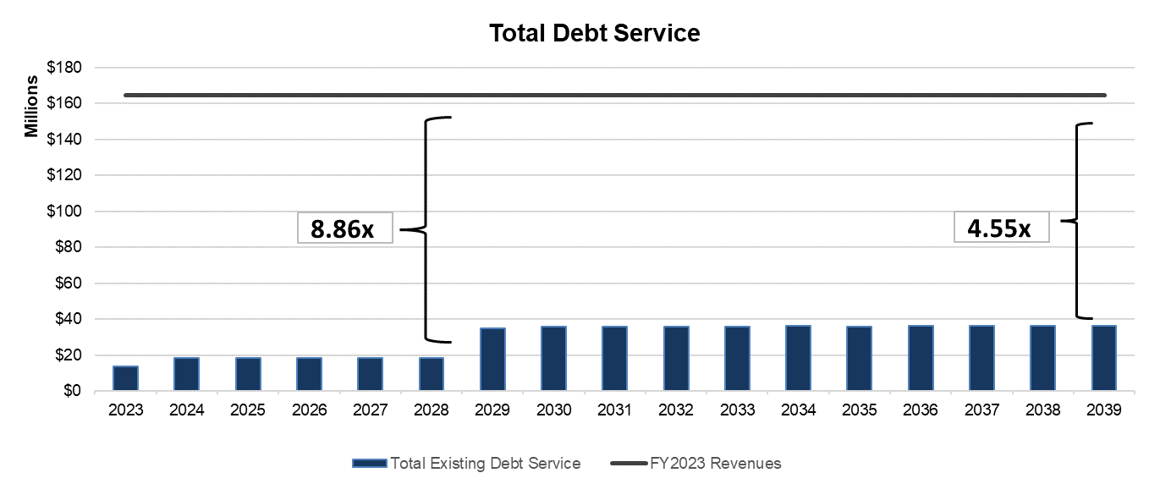
Debt Service Coverage Ratio
Annual Debt Service ranges from $13.7 million in FY2023-28 to $36.1 million in FY2029-39
Annual Debt Service (DS) Coverage (with FY2022 budgeted revenues = $164.4 million)
  Annual DS coverage through 2028: 8.86x
  Maximum Annual DS coverage: 4.55x

Slide 11
3. Potential Swap Refunding

Slide 12
Potential Refunding of Interest Rate Swaps and Variable Rate Bonds
Issue fixed rate bonds to:
  Refund $318.3 million of variable rate bonds
  Pay for $34 million termination cost of eliminating the interest rate swaps
  Secure call option on the new bonds to refinance in 2033 for potential debt service savings
Pros
  Eliminates all variable rate bonds and interest rate swaps
  Simplifies portfolio and reduces risk
  Provides flexibility to refund fixed rate bonds in 2033 for potential future savings
  Eliminates any uncertainty with upcoming (June 2023) LIBOR index transition
Cons
  Current rates increase total debt service costs by $12.6 million (NPV) through 2039: 3% increase
  Would reduce funding available for the Five-Year Capital Improvement Program

Slide 13
Swap Termination & Refunding Results
Refunding all of the variable rate bonds and terminating the interest rate swaps by issuing new fixed rate bonds would increase debt service by $14 million through 2039: a 3% increase in debt service through 2039
The new bonds could be refunded in 2033 with the potential for savings at that time

Slide 14
Future Bonds Refunding
If STA refunds the callable future bonds in 2033, the debt service savings is $15.5 million (net present value)
  Future rate assumption: The 20-year average of tax-exempt rates
Net overall savings of $2.8 million from the 2023 potential issuance

Slide 15
Future Bonds Refunding – Breakeven Even Analysis
Rates would need be +50bps (0.50%) above their 20-year average in order to stay above ($12.6) million in debt service savings and breakeven compared to today’s increase in debt service costs
2033 rates equivalent to the 20-year average + 0.50% = $12.9 million in debt service savings through 2039

Slide 16
4. Next Steps

Slide 17
Next Steps
Staff is looking for direction on bond refunding
Should the Board provide that direction, staff would move forward with the following:
  STA would release a Request for Proposals to select an underwriting team
  STA and financing team would prepare bond refunding documents
  Staff would then come back to the STA Governing Board to approve the following action:
    Refunding of the 2009C, 2014A, AND 2015A series bonds from variable rate to fixed rate
    Termination of the existing swap agreements and all other agreements needed to support variable rate bonds

Slide 18
Appendix

Slide 19

Interest Rate Swap Overview
An interest rate swap is a contract between two counterparties to exchange interest rate payments over time.
Purpose: the swap contract locks in the fixed rate.
SWAP CONTRACT
Fixed Swap Rate¹ = 3.712%
Bank Counterparties
Bank of America
Goldman Sachs
JP Morgan
Variable Rate

Slide 20

Interest Rate Swap Overview
The swap locks in the rate – the variable rate bonds raise funds for projects
To the extent that variable-rate-1 = variable-rate-2 (i.e., inflows equal outflows) STA’s net payment is the fixed swap rate
SWAP CONTRACT
Fixed Swap Rate¹ = 3.712%
Bank Counterparties
Bank of America
Goldman Sachs
JP Morgan
Variable Rate 1
STA Variable Rate Bonds
Variable Rate 2
Bondholders

Slide 21
Thank You

