Slide 1
Sacramento Regional Transit District FY 20 LPP Competitive Project Nomination
Jofil Borja Senior Community Relations Officer

Slide 2
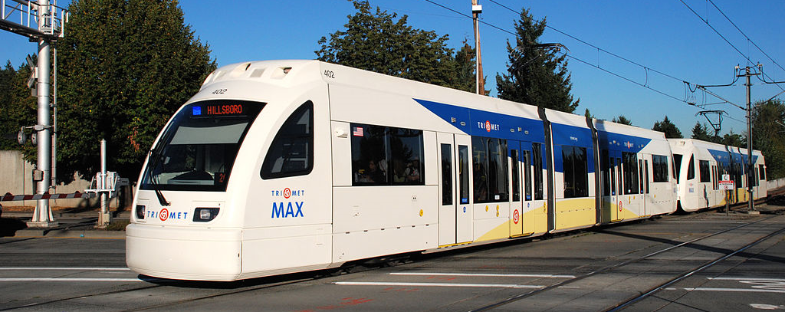
Sacramento Valley Station (SVS) Loop
Double tracking of existing light rail system on H St. and 7th St.
Realignment of SacRT’s SVS light rail station
Purchase of 7 new low-floor light rail vehicles

Slide 3
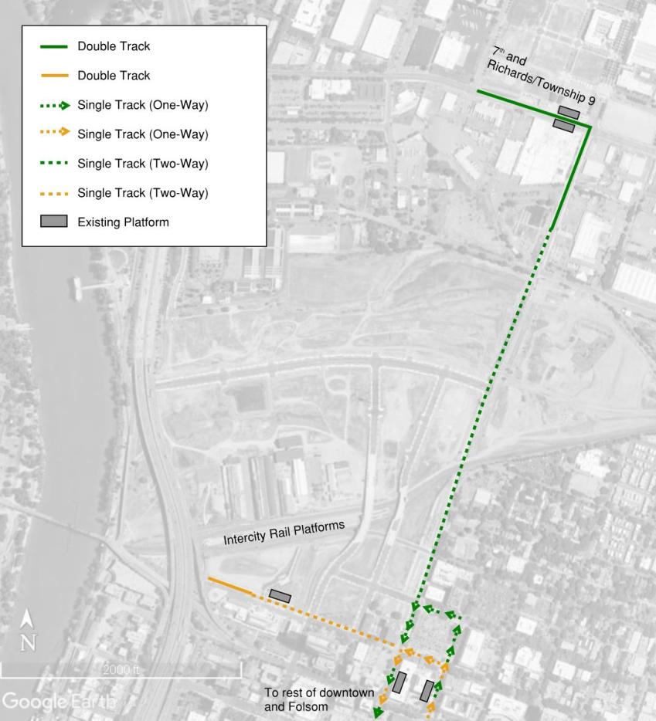
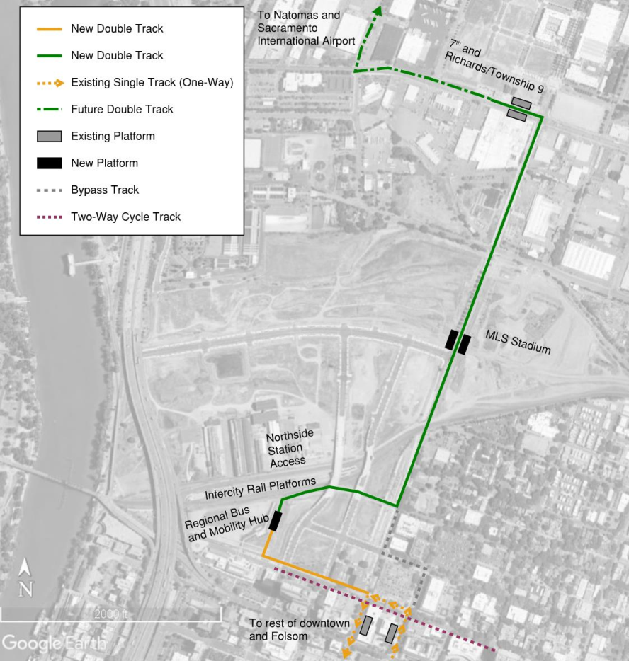
Double Tracking Section
Existing
Proposed

Slide 4
Station Realignment
Existing
Proposed

Slide 5
Project Benefits + CTC Guidelines
VMT and Congestion Reduction: 664,811,657 (per CARB Quantification Methodology Tool) over the life of the project
GHG Reduction: 182,053 MTCO2 (per CARB Quantification Methodology Tool) over the life of the project, meeting regional goals
Deliverability: 1:1 match, project can be phased to deliver components as grants develop

Slide 6
Project Benefits (continued)
Economic Development and Job Creation: will create jobs and support planned growth in railyards
System improvements for reliability, safety, and access: project meets all metrics identified by CTC and improves15 minute service and transit ridership between SVS and Township 9

Slide 7
Project Funding
Total Cost: $133,800,000
LPP Competitive Request: $10,000,000
LPP Request Match: $10,000,000 (SACOG Regional Funds (CMAQ, STIP,STP) and City of Sacramento Measure A funds)
*Future funds: Applying for $70 million of TIRCP (next round of funding), $5 million of City of Sacramento Measure A funds, $15 million of SACOG Regional funds and $21 million of SacRT Measure A Funds.

