Slide 1
2020 Local Partnership Program (Competitive) Kammerer Road Complete Reconstruction Bruceville Road to Lent Ranch Parkway
Presented by:
Kevin Bewsey, City of Elk Grove Capital Program Division Manager
May 14, 2020

Slide 2
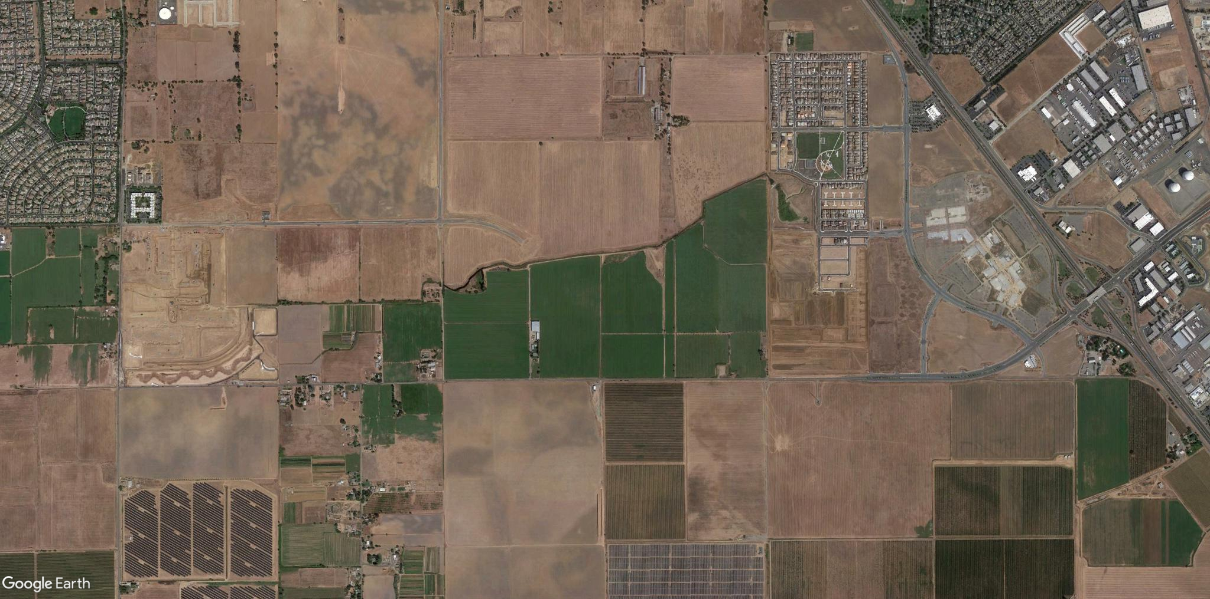
Project Location
Big Horn Boulevard
Lotz Parkway.
SR-99
Grant Line
Road
Lent Ranch Parkway
Bruceville Road
McMillan Road
Kammerer Road

Slide 3
Project Summary
Reconstruct 2.5 miles of existing Kammerer Road
Two lane divided roadway
Shoulder/class III bikeway
Median or two-way left turn lanes

Slide 4
Project Limits
Big Horn Boulevard
Bruceville Road
Lotz Parkway.
SR-99
Grant Line
Road
Lent Ranch Parkway
McMillan Road
Kammerer Road
2018 SB1 LPP Grant - $3M for Construction with a $3M Local Match
2020 SB1 LPP Grant Request
2020 SB1 LPP Grant Request

Slide 5
Competitive Criteria
Cost Effective
Combines two separate City projects to build at once.
Deliverability
Projects already underway with CEQA complete and R/W offers made.
Leveraging Funds
Leverages previous LPP competitive funds
Air Quality/GHG/VMT Reduction
Adds a 6’ wide Class 3 bikeway in each direction.
Regional/Community Support
Included in Existing Measure A
Public Outreach Completed
Regional/Local Plan
Included in the 2020 MTP/SCS

Slide 6
Competitive Criteria, Safety and Preservation
Safety
Adds shoulders.
System Preservation
Reconstructs existing road.
Notes:
PCI is 66, 60 west of mcmillan

Slide 7
Project Schedule
December 2018 – Environmental Document Secured
December 2020 – ROW Acquisitions Completed
January 2021 – Advertise for Construction
Spring 2021 – Start of Construction
Fall 2021 – Construction Completed

Slide 8
Project Cost
Total Project Cost = $25.6M
Preliminary Engineering – $1.8M
Other Capital Costs – $300K
ROW – $5.8M
Environmental – $900K
Construction & CM - $16.8M
2018 SB1 LPP Grant = $3M with equal $3M local match

Slide 9
Questions

