Slide 1
2024 Agreed Upon Procedures
Presented by:
Nick Parkins, CPA, Audit Supervisor
February 27, 2025
Notes:
Title slide

Slide 2
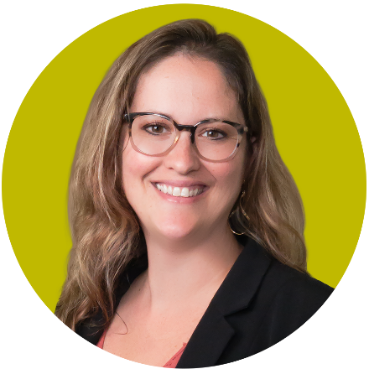
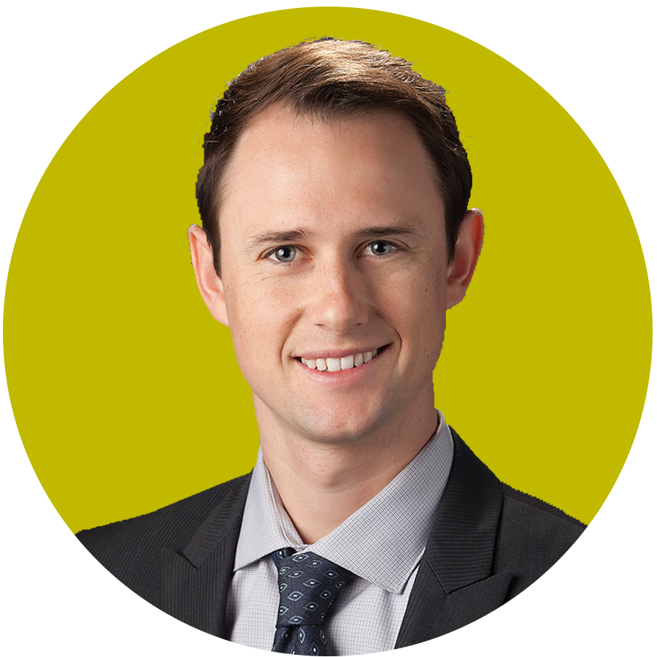
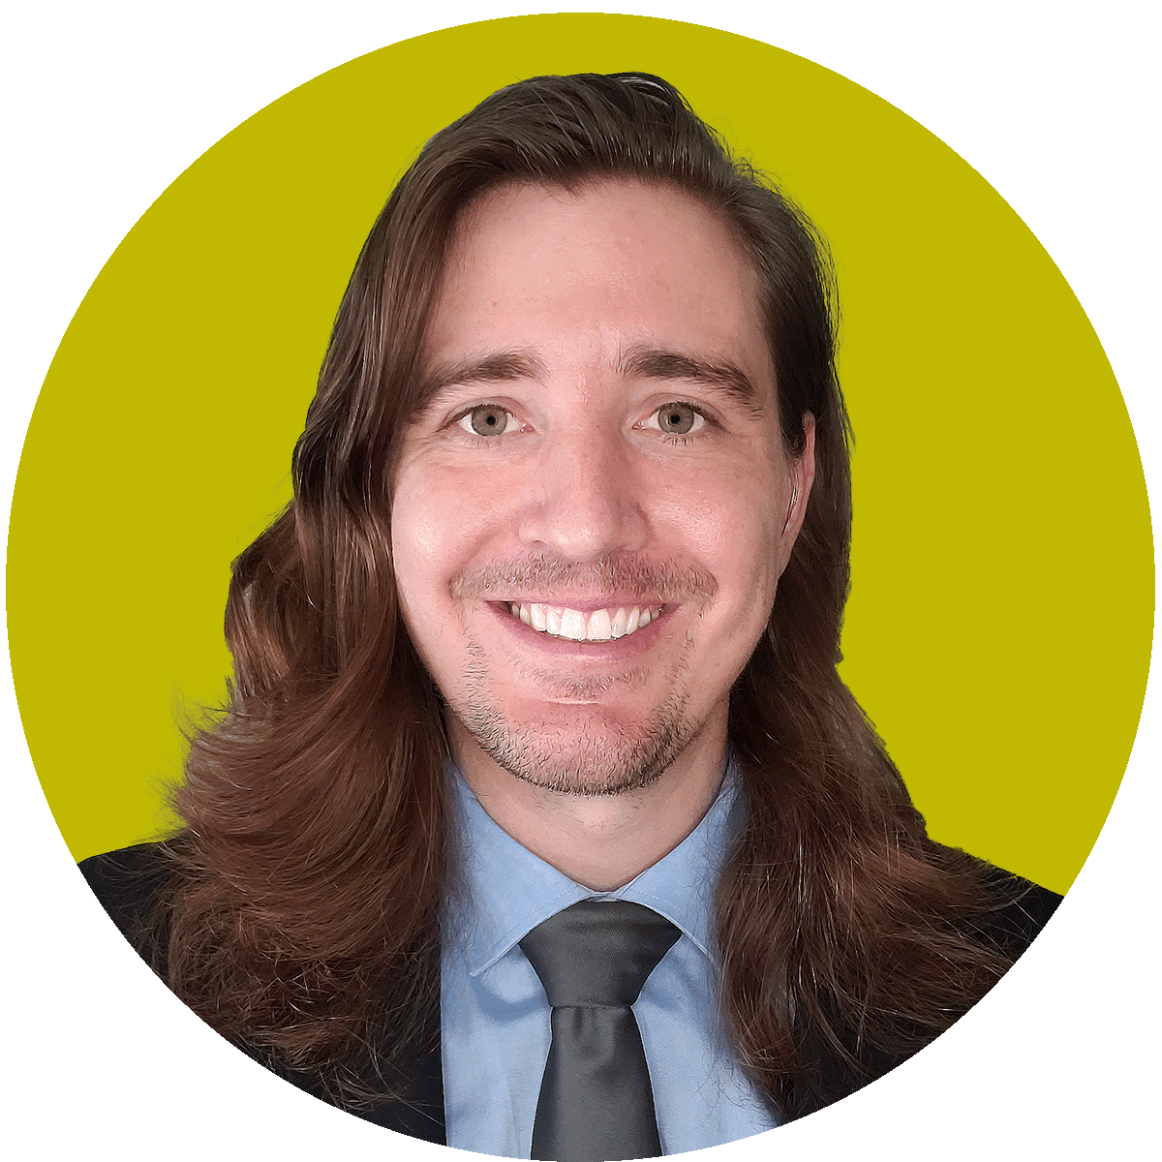
Your LSL Team
Christian Townes, CPA
Partner
Assurance & Advisory
Riley Greenlee, CPA
Manager
Assurance & Advisory
Nick Parkins, CPA
Supervisor
Assurance & Advisory
Notes:
You can replace the pictures by right-clicking on the image and selecting ‘change picture’

Slide 3
Scope of Engagement
LSL has been engaged by the Sacramento Transportation Authority to perform the following agreed upon procedures:
  Review distributions of Measure A revenue received by the authority and the use of those funds by local agencies and the Authority for the purposes detailed in the Measure A Ordinance
  Assess internal controls over payment processing to determine if there were any deficiencies
Notes:
Example of bulleted text slide – single column

Slide 4
Scope of Engagement
Compliance agreed-upon procedures
  August 12 – August 15, 2024
    Detailed testing of compliance with measure A Ordinances
    Other procedures necessary to obtain sufficient, appropriate evidence
  Additional work performed in response to additional detailed requests and outstanding items between September and December 2024
Notes:
Example of bulleted text slide – 2 columns

Slide 5
Results of Compliance Agreed Upon Procedures
We noted no material exceptions in our review of compliance with the Measure A Ordinance. We had best practice recommendations to improve the monitoring and compliance of the program in the following areas:
  Monitoring of timeliness of Measure A allocation spending
  Implementation of a limitation to the extension of contracts under Measure A
  Implementation of a policy for local agencies to present program balance information
  Strengthening of impact fee forecasting methods
Notes:
Example of bulleted text slide – single column

Slide 6
Questions
Notes:
Questions slide

Slide 7
www.lslcpas.com contact.us@lslcpas.com
CALIFORNIA: Irvine | Sacramento
TEXAS: The Woodlands
Notes:
Contact information slide

