Slide 1
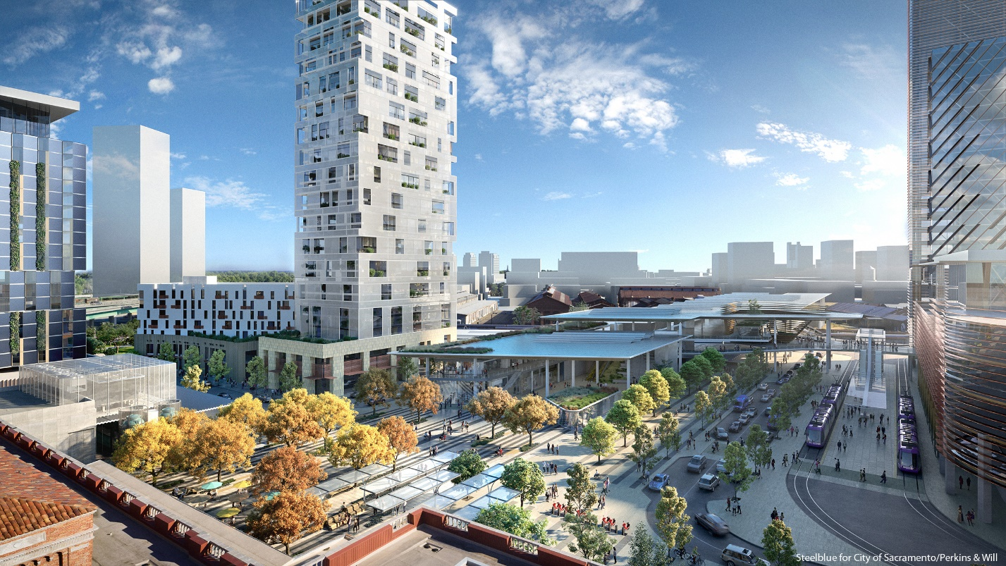
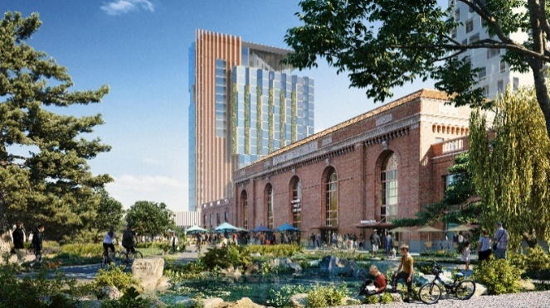
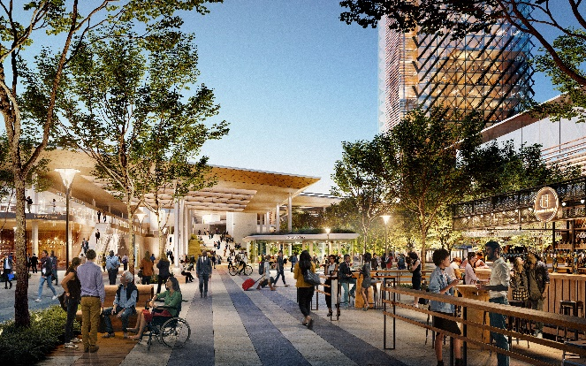
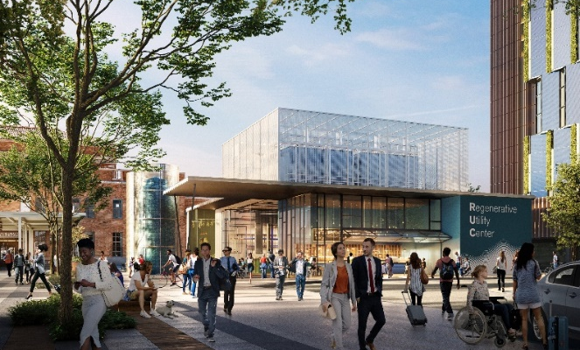
Outline
  Recap of SVS 3-Phase Plan
  Highlights Area Plan (Phase 3)
  Strategic Use of STA Funds
  SVS Governance & Operations Analysis
  Questions
Sacramento Transportation Authority ITOC Meeting
February 29, 2024

Slide 2
Sacramento Valley Station Current Statistics
25 YEARS OF CITY LEADERSHIP ON THE REGION’S MOST IMPORTANT TRANSPORTATION FACILITY
City has leveraged over $199M in State and Federal Funding using primarily Measure A Sales Tax approved by the voters for transportation improvements
Sacramento Valley Station Total Ridership (FY19): 1.7 million total riders
Station National Amtrak Ranking for Ridership: 7th Busiest Amtrak Station in the Nation (FY2019)
Amtrak National Rail Routes Ranking: #3 – Capitol Corridor JPA
#6 – San Joaquin JPA
Living Community Challenge Vision Plan Sustainability – 1st Municipality to Achieve
International Living Futures Institute Compliance
Sacramento Transportation Authority ITOC Meeting
February 29, 2024

Slide 3
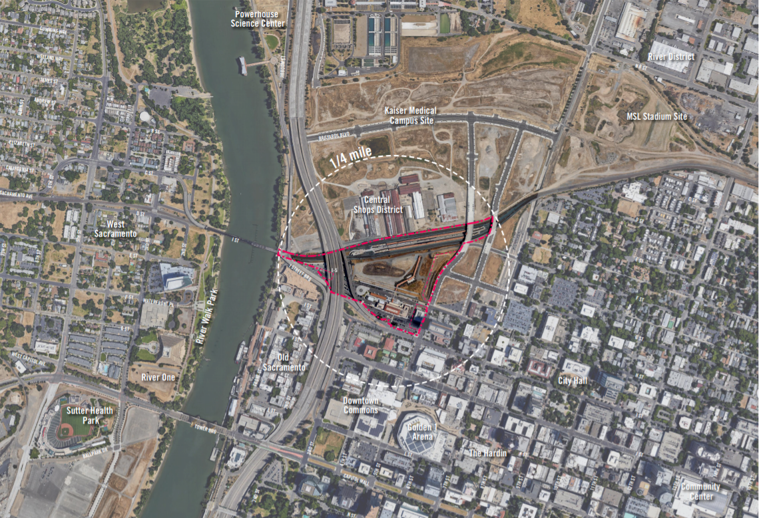
Property Acquisition 2006 from Railyards developer
$56 Million ($44M in New Measure A funds)
Sacramento Transportation Authority ITOC Meeting
February 29, 2024

Slide 4
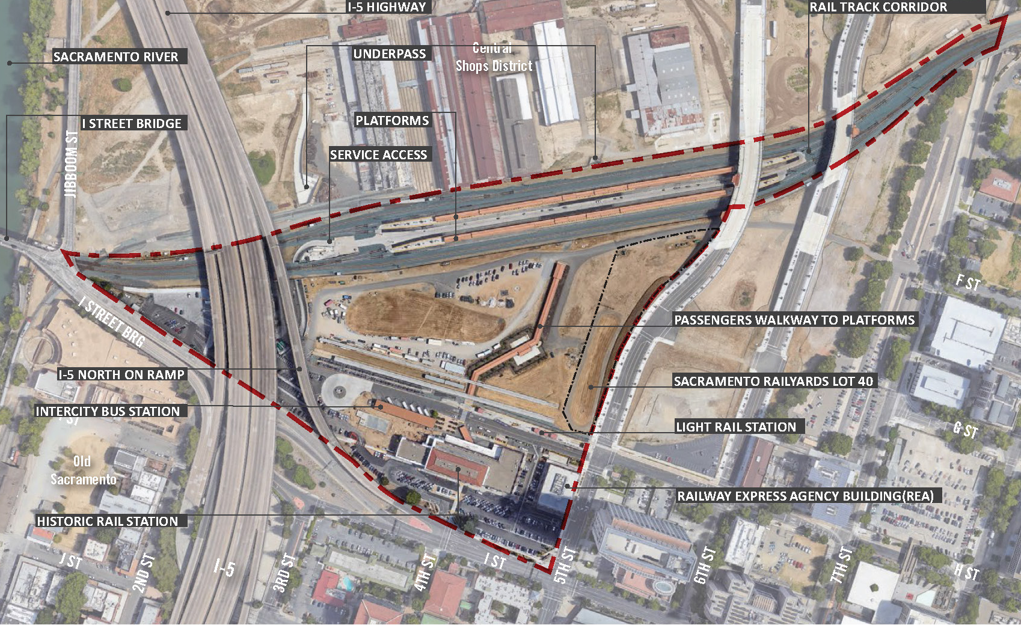
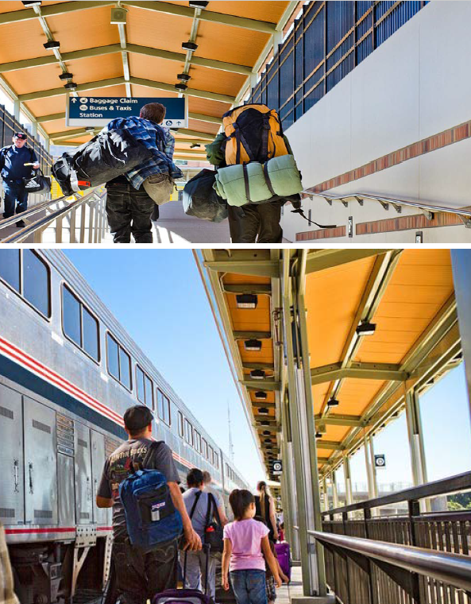
2008-2013 Phase 1 - Track Relocation Project – Design through Construction and Seismic upgrade to historic station.
Total Project Cost : $83.8 Million
Funds Leveraged: $40.8M Federal and $25.2M State
1996 to 2021
Sacramento Transportation Authority ITOC Meeting
February 29, 2024

Slide 5
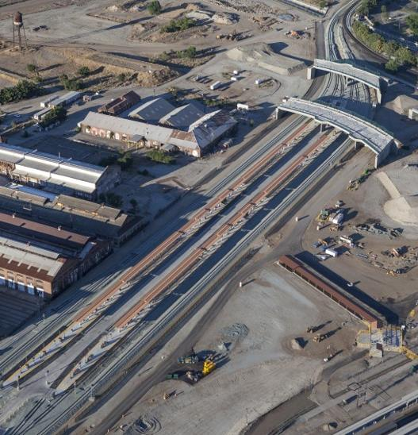
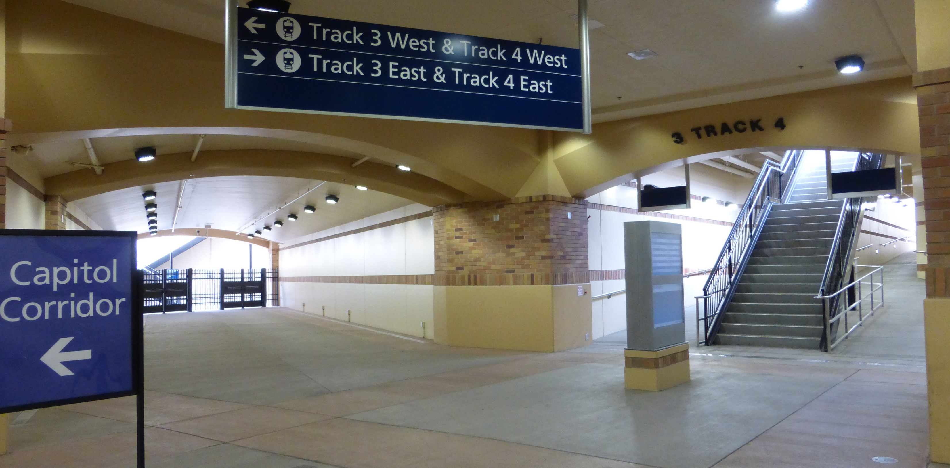
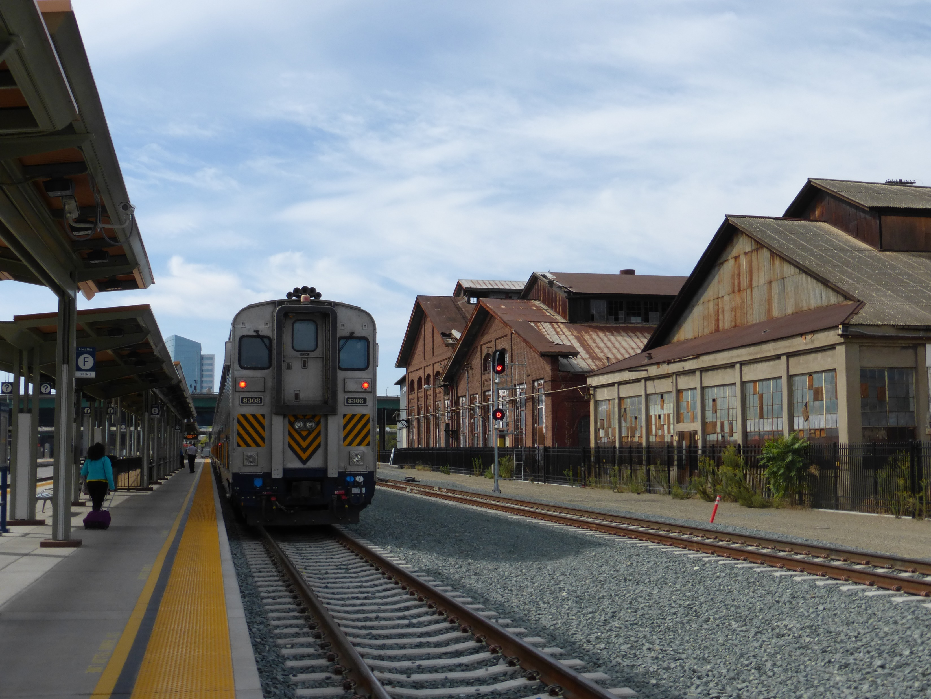
Sacramento Transportation Authority ITOC Meeting
February 29, 2024
Notes:
Phase 1 – Track Relocation & Platforms
Project Goals :
Realign 3,300 mainline track, adding station platforms and access tunnels
Improve freight movement & safety
Improve passenger safety with grade-separated access to trains
Prepare site for expanded future station

Slide 6
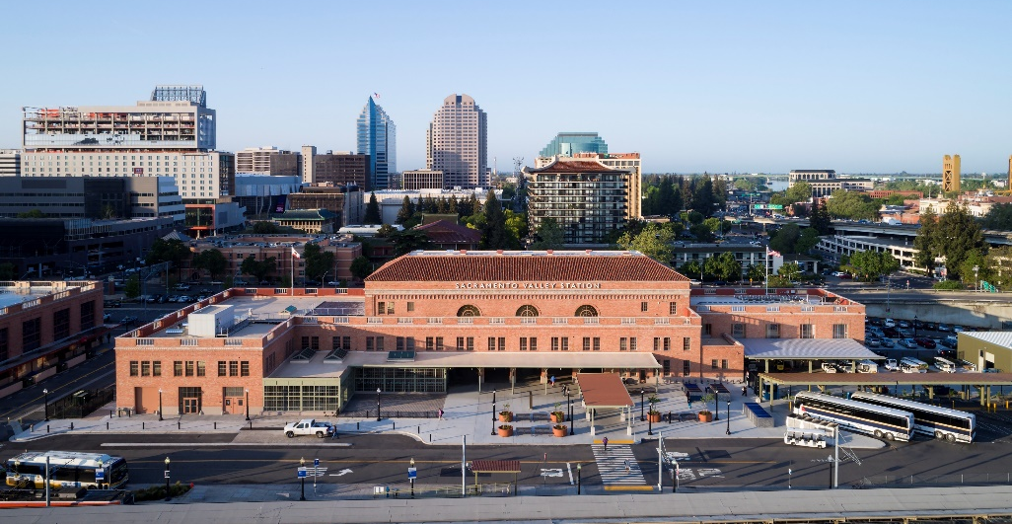
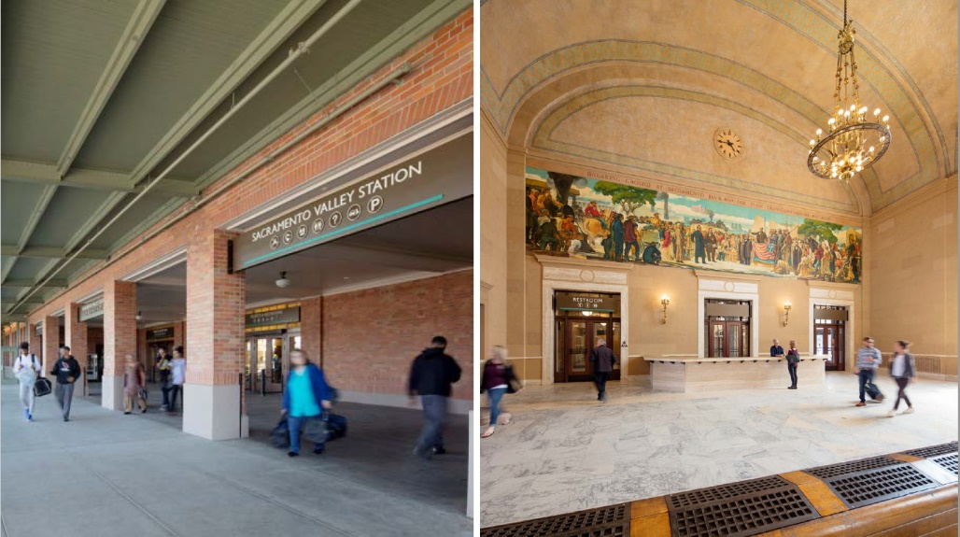
2012-2017 Phase 2 – Historic Station renovation & Seismic upgrade, design through construction
Total Project Cost: $51.9 Million for Seismic upgrade & building renovation
Seismic: $13.5M with $2.2M FTA funds / $10.5M State funds
Renovation: $46.1M with $15M TIGER (FRA) /$3.7M other fed
1996 to 2021
Sacramento Transportation Authority ITOC Meeting
February 29, 2024

Slide 7
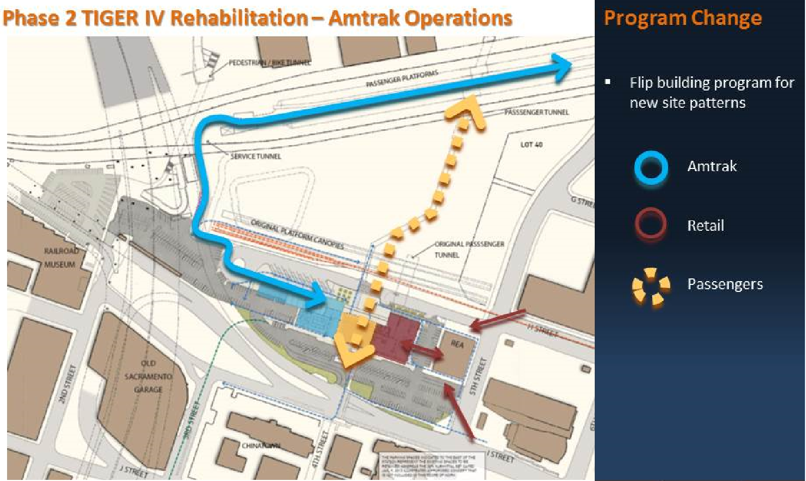
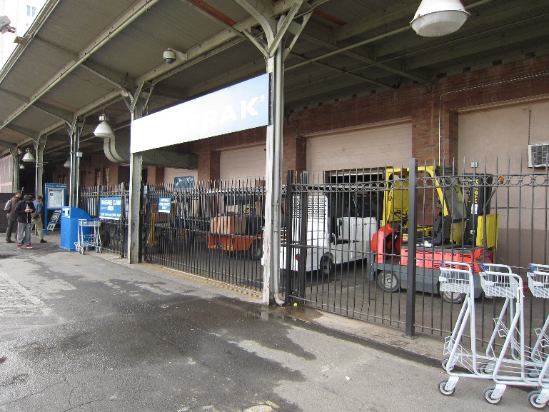
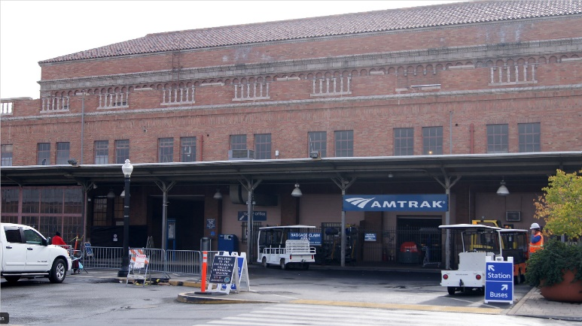
PROJECT ORIENTATION
Sacramento Transportation Authority ITOC Meeting
February 29, 2024

Slide 8
Sacramento Transportation Authority ITOC Meeting
February 29, 2024

Slide 9
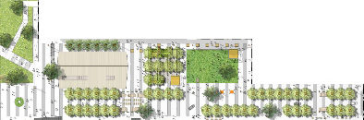

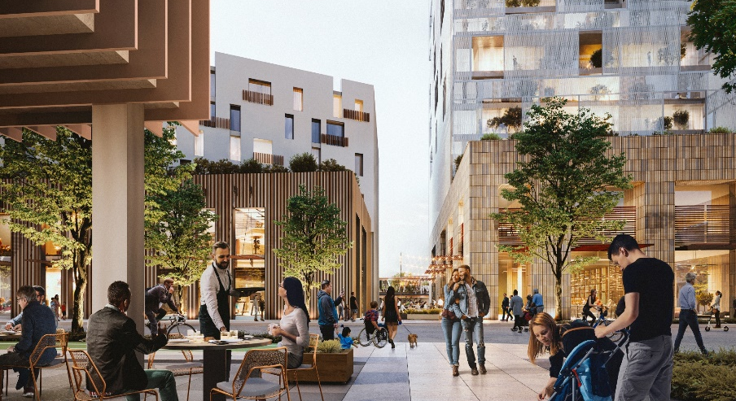
2017- 2021 Phase 3 Concept Master Plan - funded by the State Sustainable Communities Grant Program and Measure A Sales Tax Transportation Funds
2020 State TIRCP Grant for Construction of North Entrance to Railyards Central Shops District
Funds Leveraged: $5.5 Million to date – Pursuing $120 M state & fed next 3 years for RBMC
1996 to 2021
New North Entrance (construction 2024)
Sacramento Transportation Authority ITOC Meeting
February 29, 2024

Slide 10
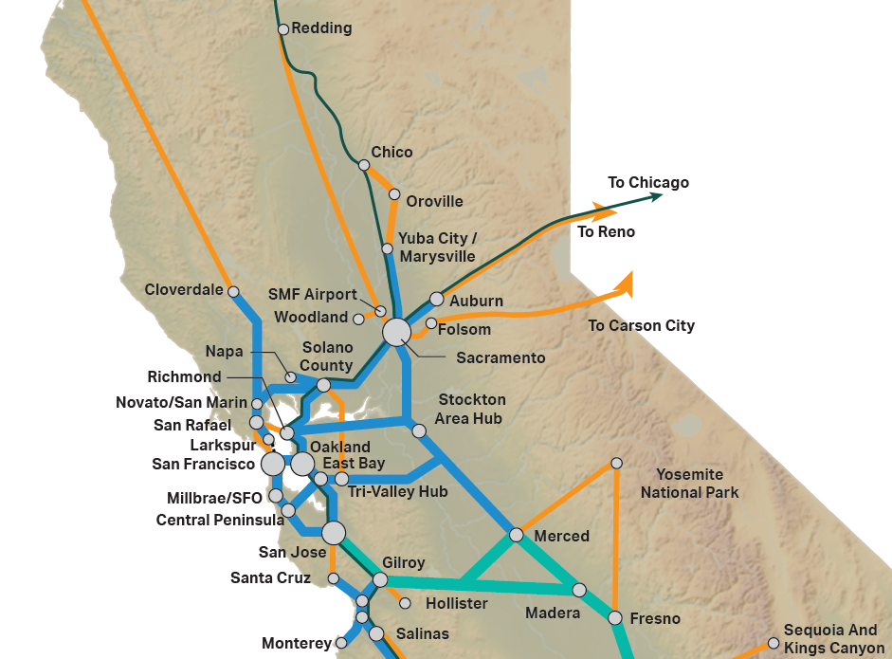

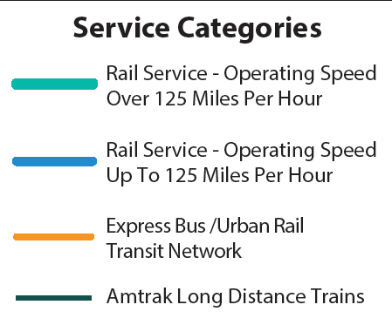
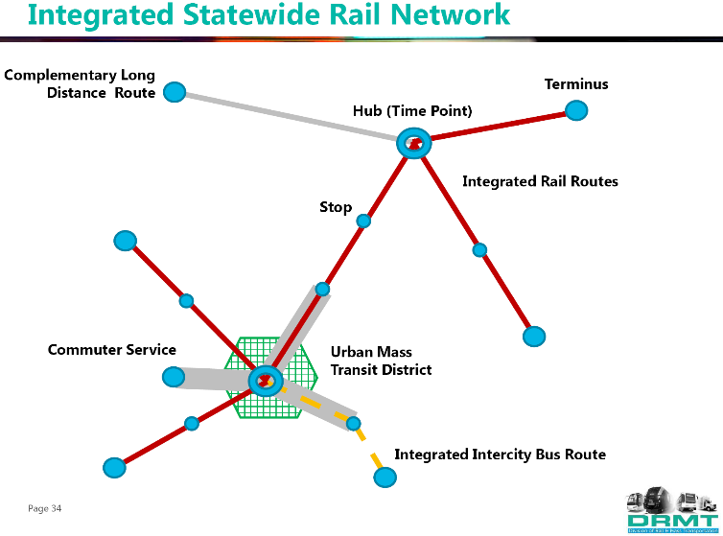
STATE RAIL PLAN – Hub Transfer System
Sacramento Transportation Authority ITOC Meeting
February 29, 2024

Slide 11
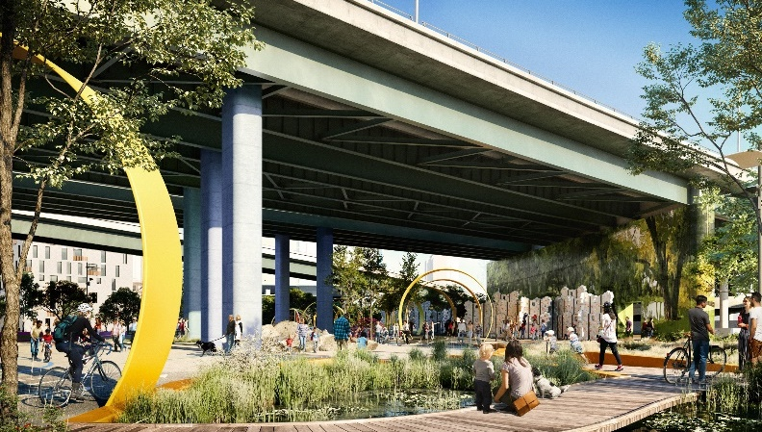
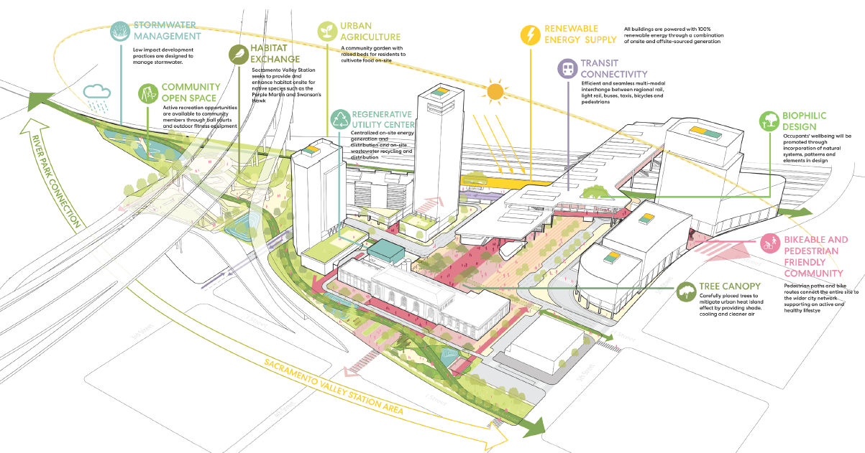
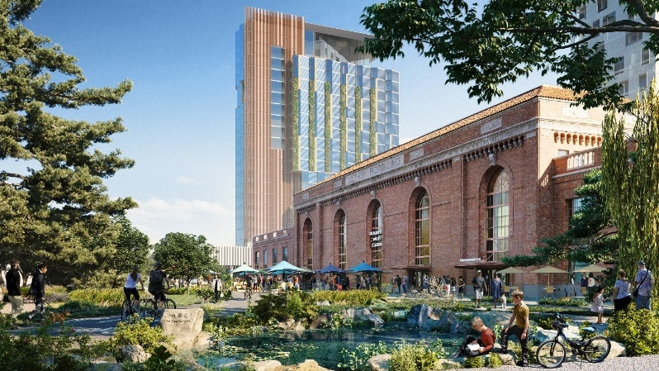

SUSTAINABILITY FRAMEWORK
Zero Carbon |Net Positive Energy |Water Reuse | Healthy Environment
Sacramento Transportation Authority ITOC Meeting
February 29, 2024

Slide 12
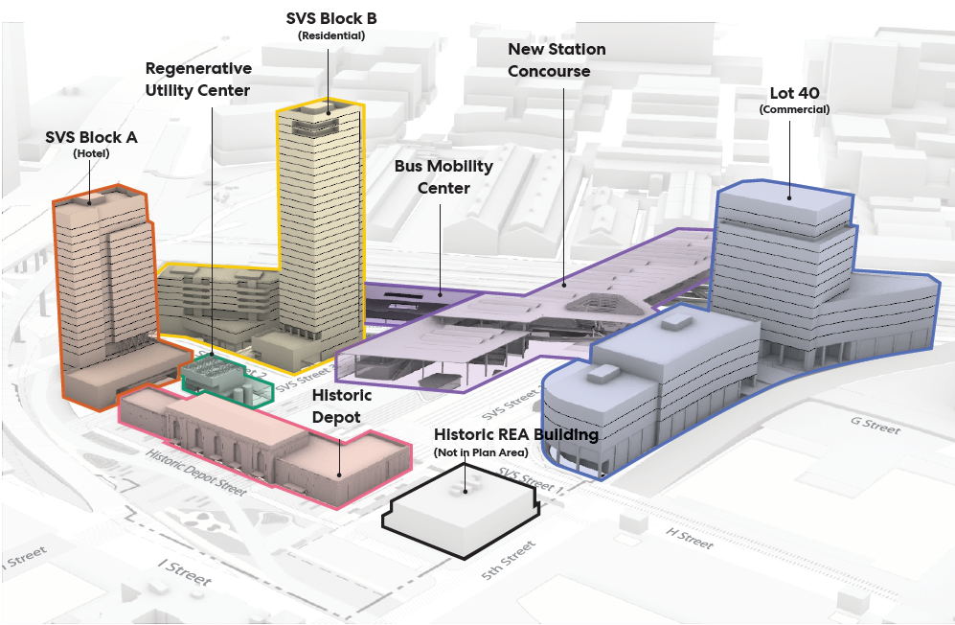
Sacramento Transportation Authority ITOC Meeting
February 29, 2024

Slide 13
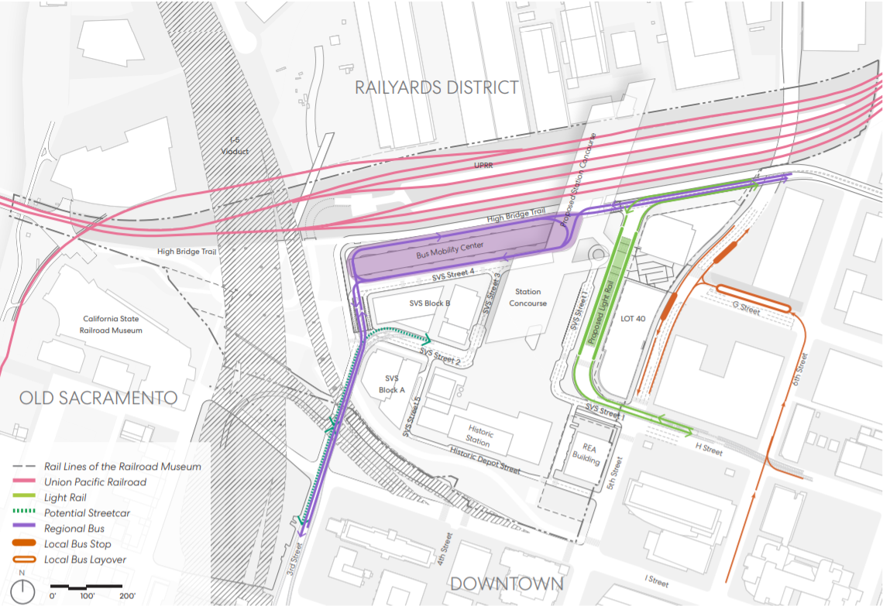
Sacramento Transportation Authority ITOC Meeting
February 8, 2024

Slide 14
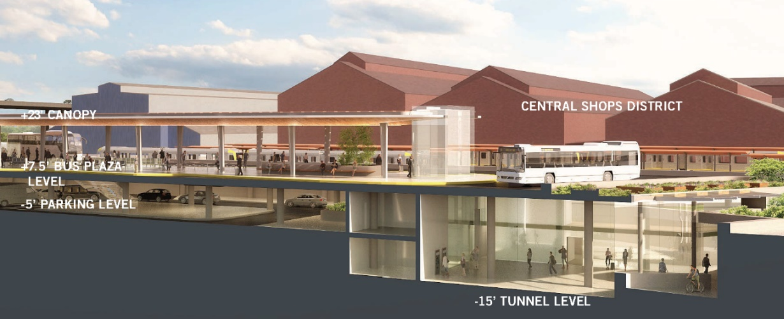
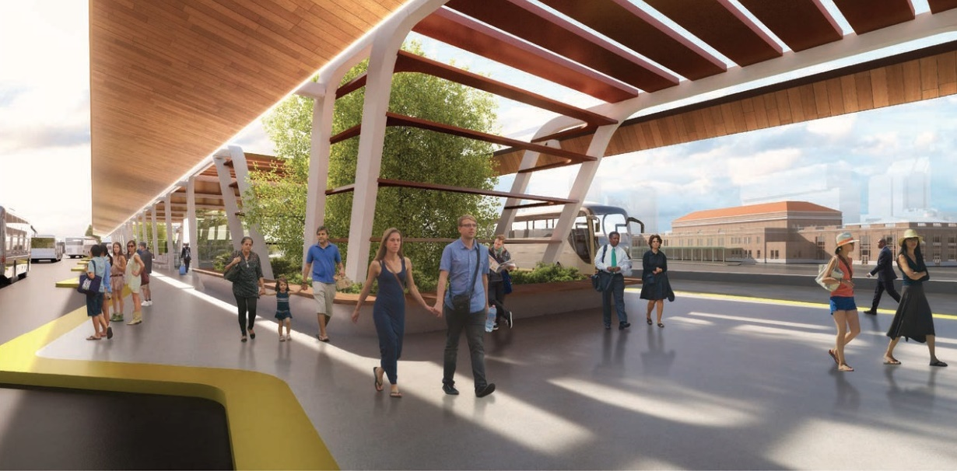
Current and Potential Tenant Agencies/Services to RBMH
Amtrak
Capitol Corridor JPA
San Joaquin JPA
Caltrans Thruway Buses
Sacramento Regional Transit
Fairfield Transit (FAST)
El Dorado Transit
Amador Regional Transit
Butte County Transit (proposed)
Elk Grove Transit (SacRT)
Flixbus
Folsom Stage Lines
Galt-Sacramento Commuter Express
Greyhound
Natomas JIBE
Placer County Transit
Roseville Transit
SacRT SmaRT Ride
SacRT GO Paratransit
San Joaquin RTD
Shasta Regional Transit Agency
West Sacramento Via
Yolo County Transit
Yuba-Sutter Transit
Current Agency tenants at SVS
Anticipated Agency tenants with SVS Bus Mobility Center
PROJECTED TO PROVIDE 62 CITIES AND 22 COUNTIES BUS & RAIL CONNECTIONS TO/FROM SACRAMENTO VALLEY STATION
DIRECT BENEFITS TO 285 CENSUS TRACTS OF LOW-INCOME COMMUNITIES
Sacramento Transportation Authority ITOC Meeting
February 29, 2024

Slide 15
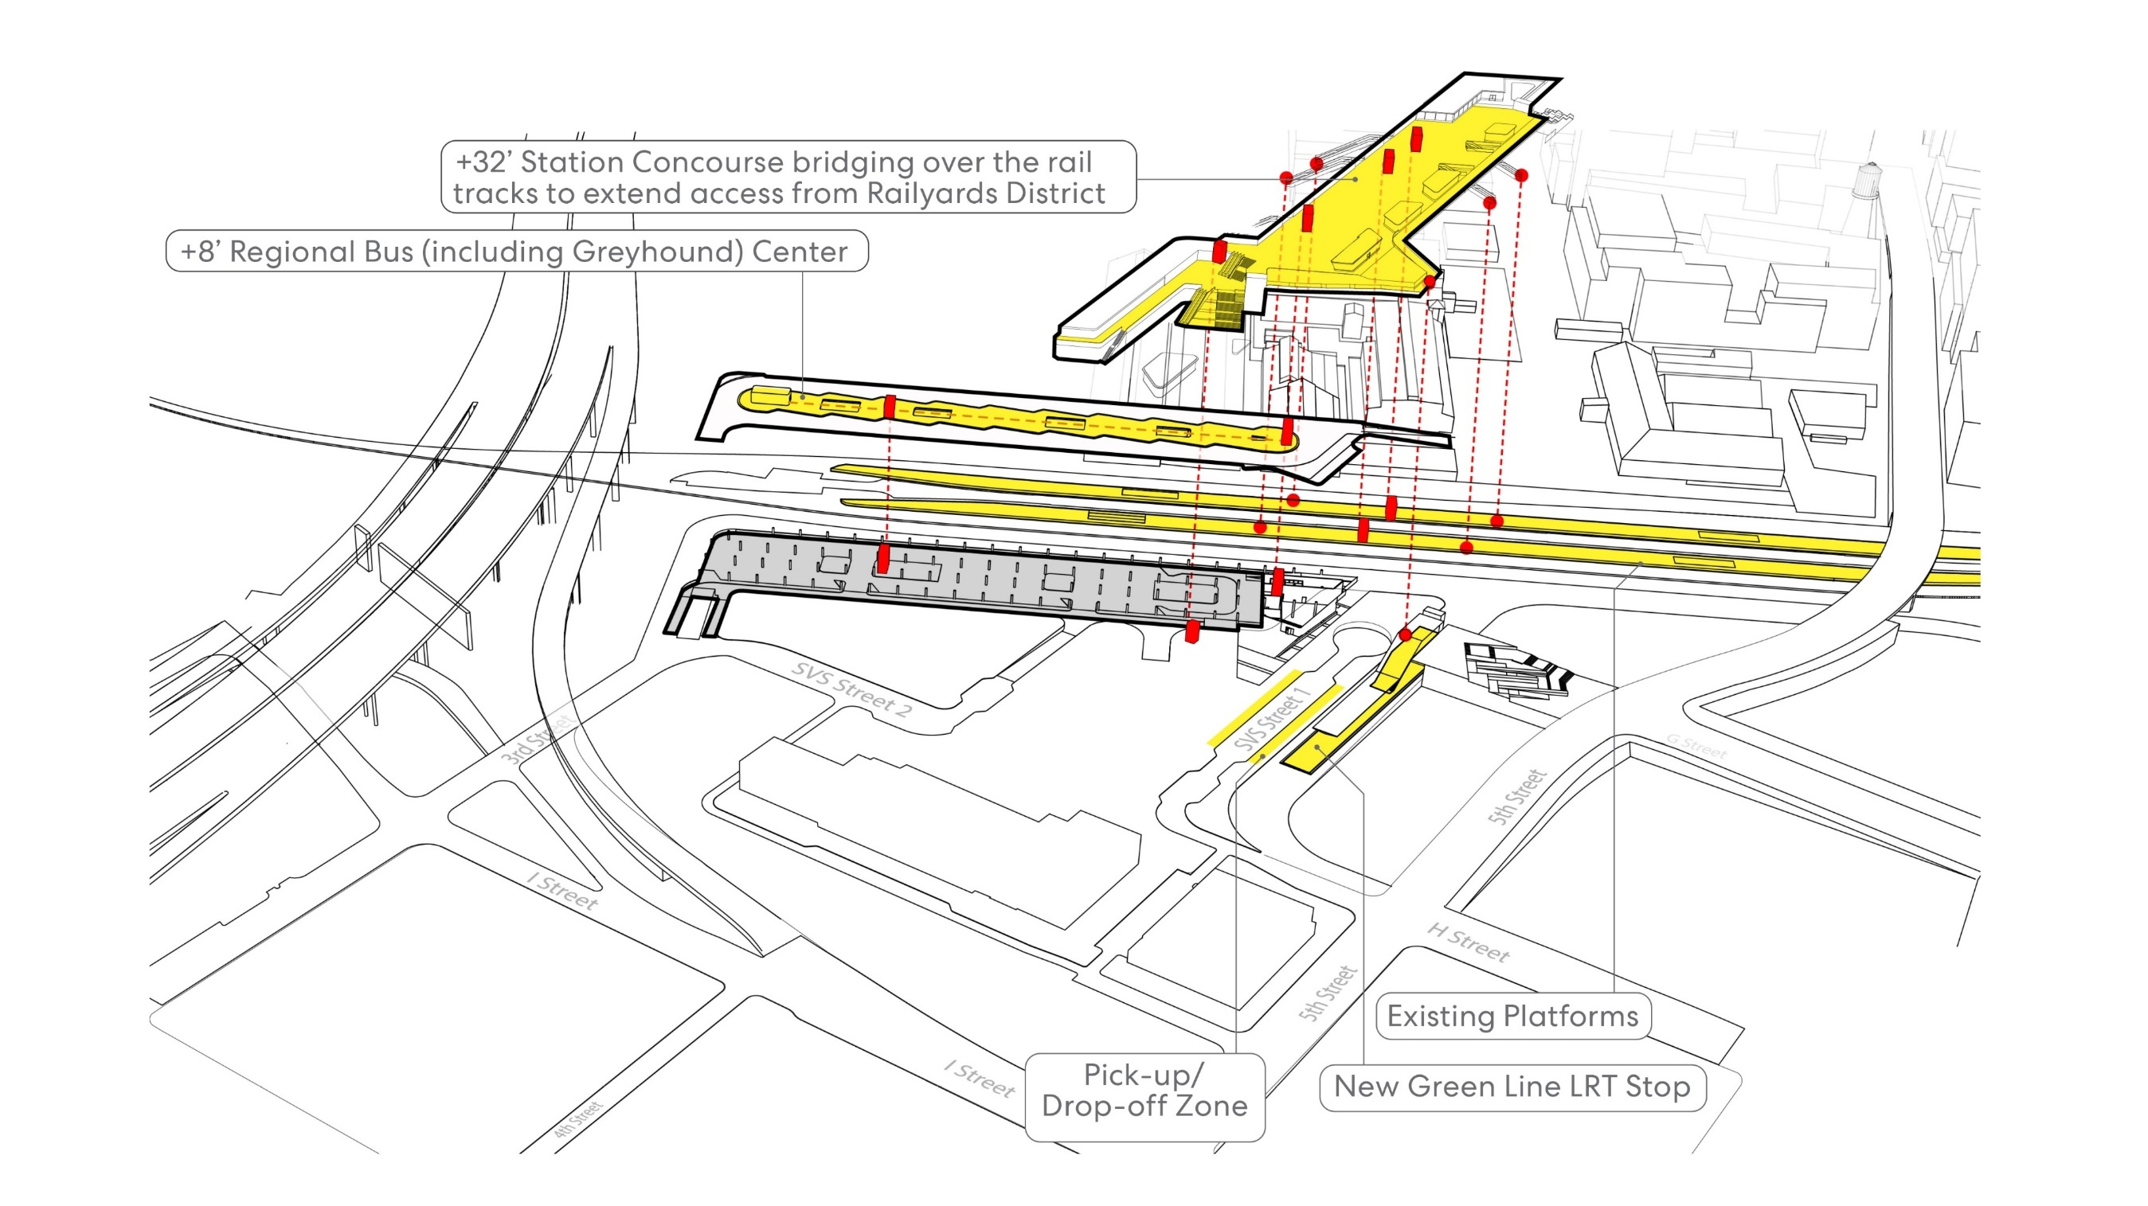
c. 2028
Sacramento Transportation Authority ITOC Meeting
February 29, 2024

Slide 16
c. 2040
Sacramento Transportation Authority ITOC Meeting
February 29, 2024

Slide 17
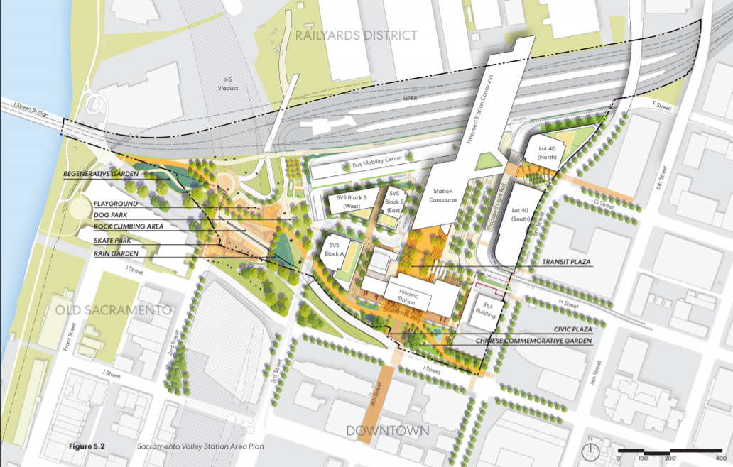
SVS/Railyard North Entrance – Construction Start 2023
#1 - Repositioning LRT and New Vehicle Access
#2
#1
#2 – Regional Bus Mobility Center – Connections to Passenger Rail System
#3
#3 – Relocate I-5 Ramp to Extend 3rd Street with direct bus access to I-5 (north & south)
Sacramento Transportation Authority ITOC Meeting
February 29, 2024

Slide 18
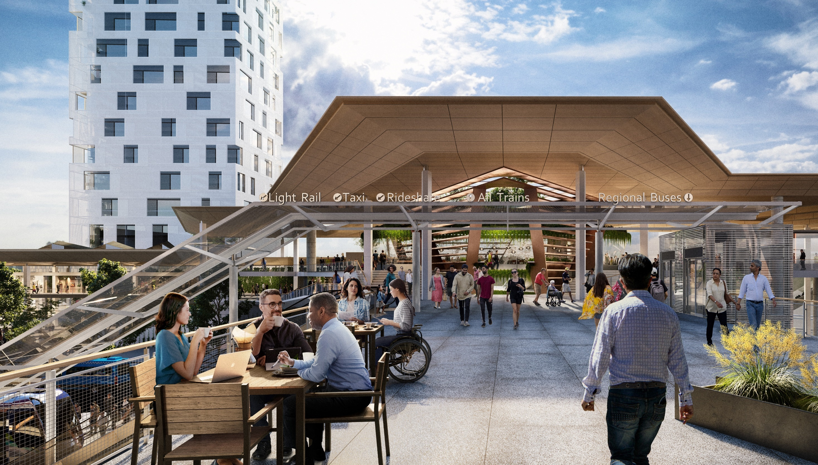
Strategic Use of STA Funds -
Grant Match and Project Leverage
Sacramento Transportation Authority ITOC Meeting
February 29, 2024
Steelblue for City of Sacramento/Perkins & Will

Slide 19
Sacramento Transportation Authority ITOC Meeting
February 29, 2024

Slide 20
#1
SVS-RAILYARDS NORTH ENTRANCE
Sacramento Transportation Authority ITOC Meeting
February 29, 2024

Slide 21
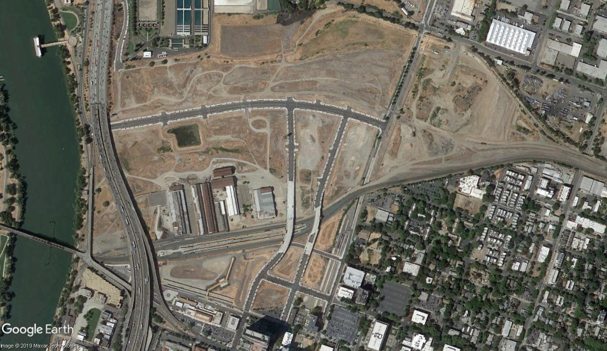
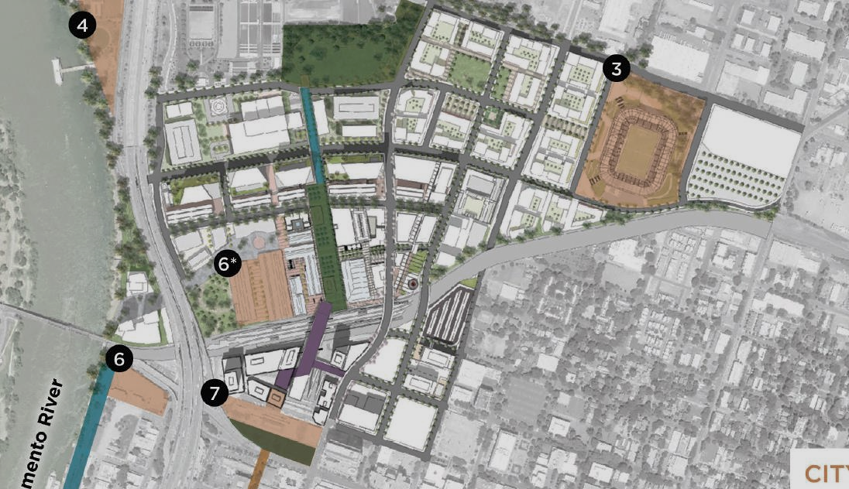
Kaiser Medical Campus
MLS
SVS/Railyards North Entrance
Sacramento Transportation Authority ITOC Meeting
February 29, 2024

Slide 22
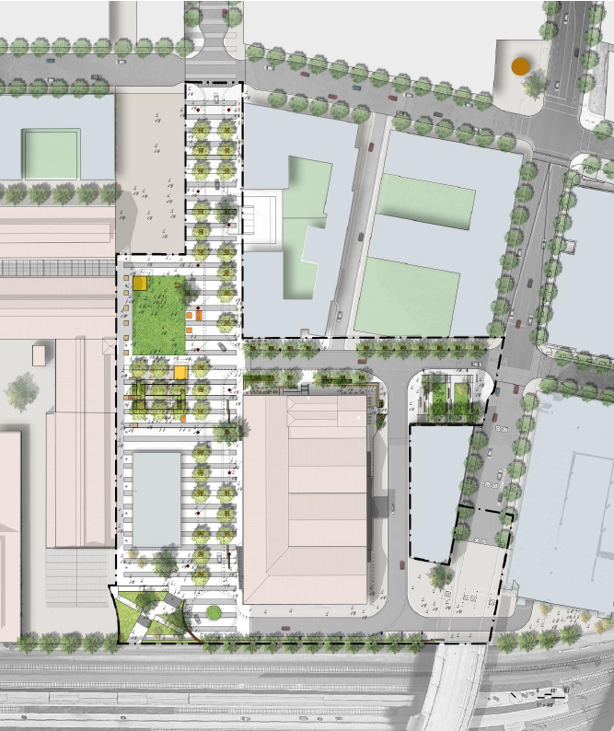
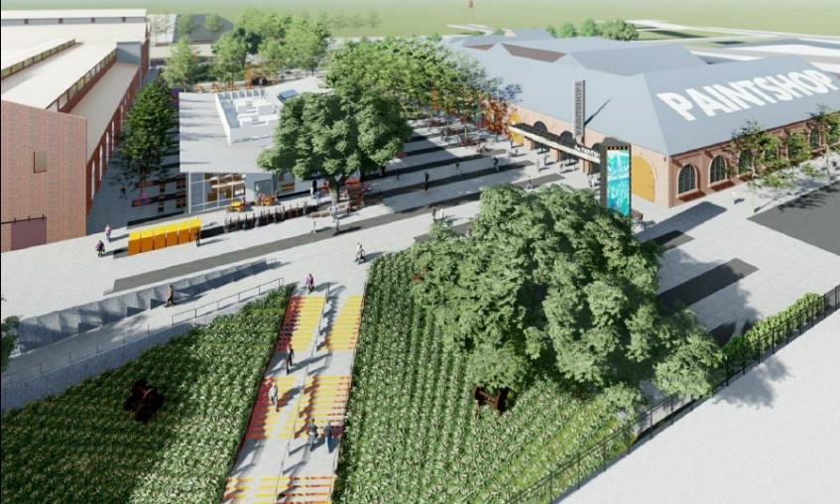
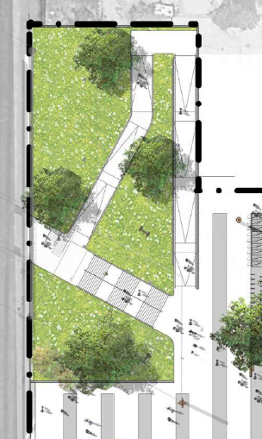
SVS North Entrance Steve Cohn Passageway to Railyards Central Shops Plaza
LIVE
NATION
Sacramento Transportation Authority ITOC Meeting
February 29, 2024

Slide 23
#2
REGIONAL BUS MOBILITY HUB
NEPA REVIEW
Sacramento Transportation Authority ITOC Meeting
February 29, 2024

Slide 24
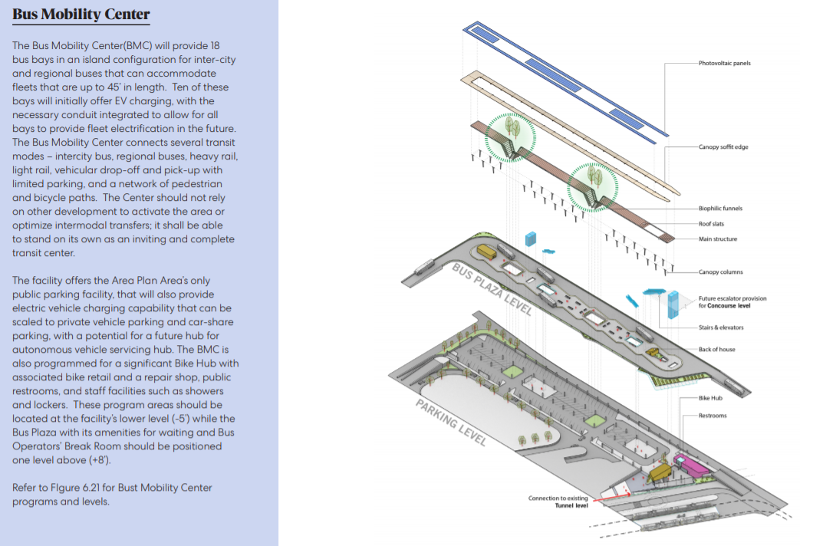
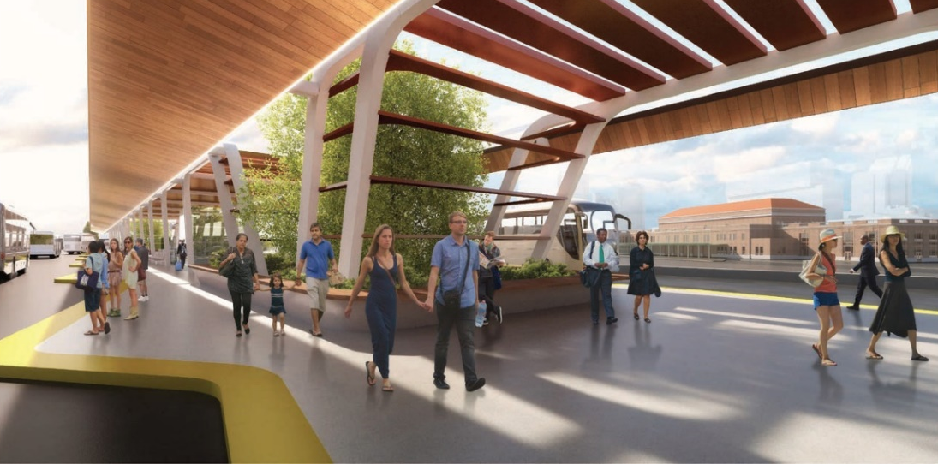
Sacramento Transportation Authority ITOC Meeting
February 29, 2024

Slide 25
#3
NB I-5 RAMP RELOCATION AND 3RD STREET TO SVS
Sacramento Transportation Authority ITOC Meeting
February 29, 2024

Slide 26
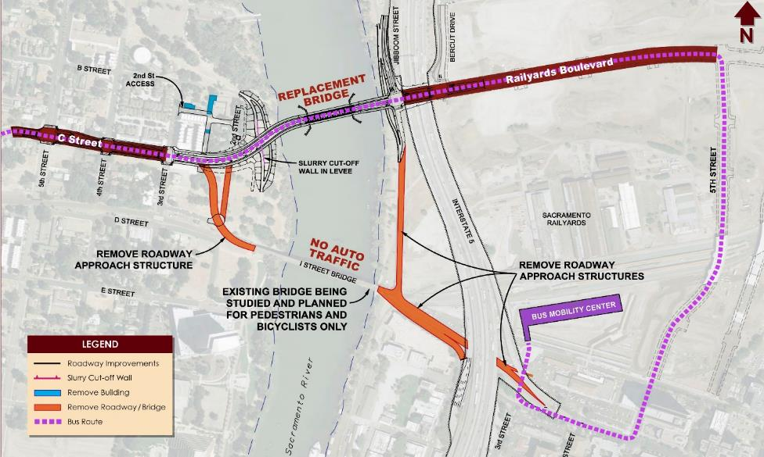
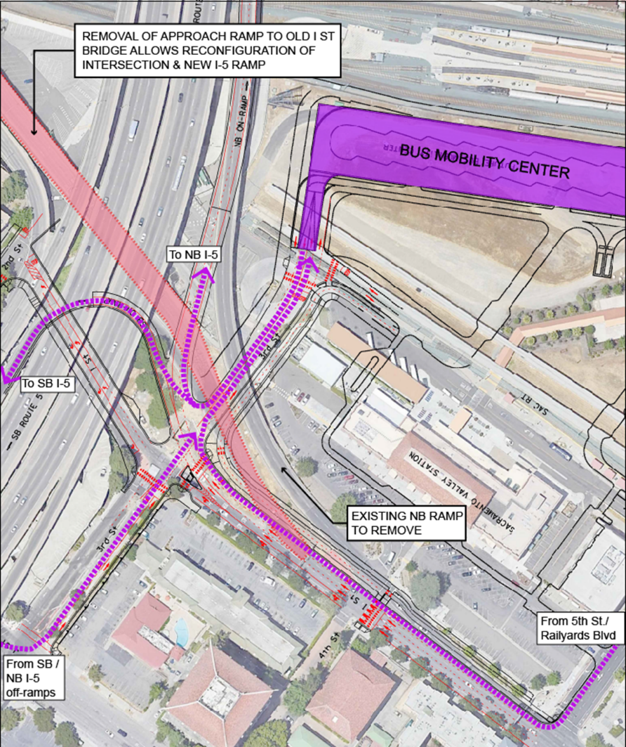
INITIAL PROJECT STUDY REPORT (PSR) FUNDED BY 2020 TIRCP
[STATE FUNDS-In Progress]
#3 I-5 RAMP RELOCATION & 3rd ST ACCESS PROJECT
(FEDERAL FUNDS)
Sacramento Transportation Authority ITOC Meeting
February 29, 2024

Slide 27
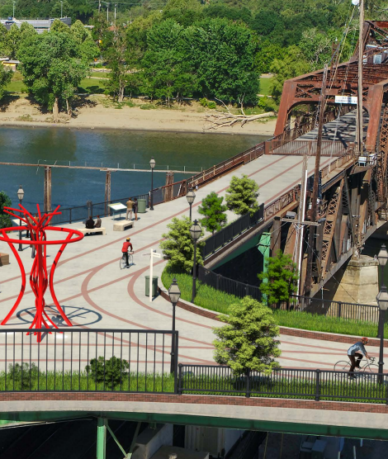
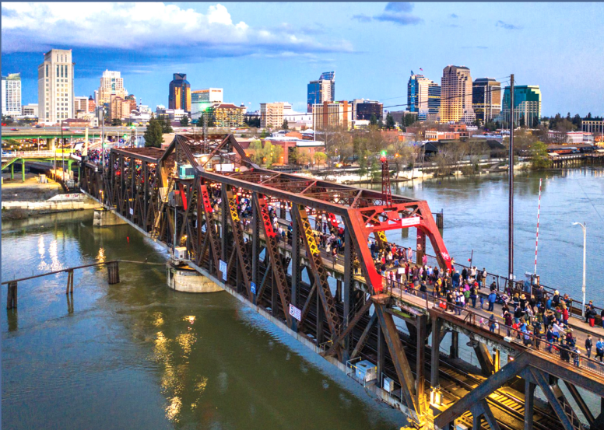
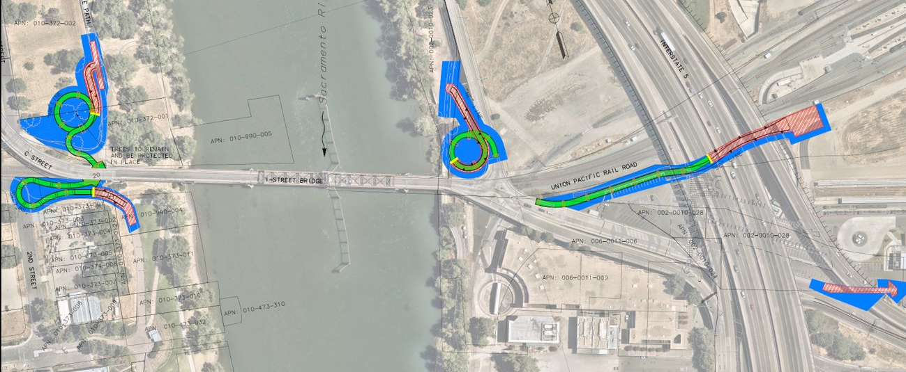
I Street Deck Conversion
Sacramento Transportation Authority ITOC Meeting
February 29, 2024

Slide 28
#4
SVS STORM DRAINAGE LINE
Sacramento Transportation Authority ITOC Meeting
February 29, 2024

Slide 29
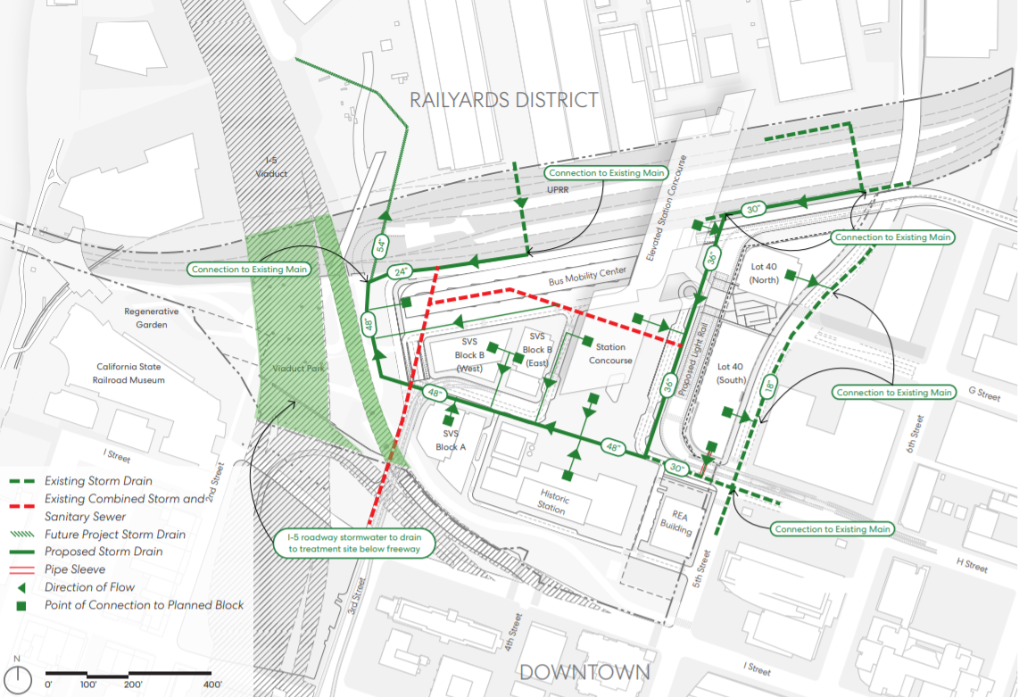
SOTA STORM DRAIN
$2.3 M DRV Implemented- Funded with $30M State Grant
$4.6M City Implement- Funding with 2022 TIRC Grant
Sacramento Transportation Authority ITOC Meeting
February 29, 2024

Slide 30
#5
H STREET CYCLE TRACK – ON STREET
(5TH STREET TO 10TH STREET)
Sacramento Transportation Authority ITOC Meeting
February 29, 2024

Slide 31
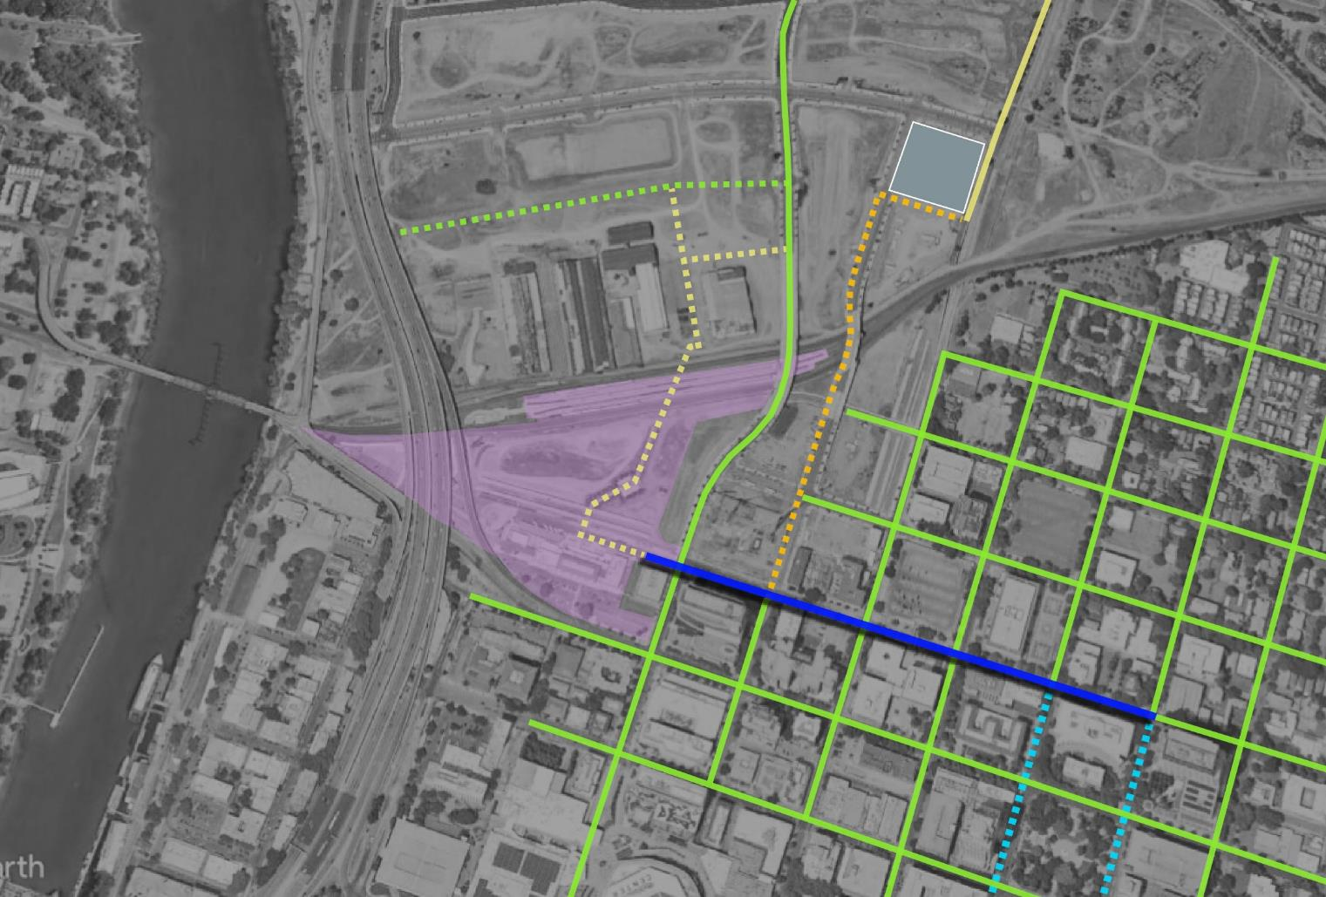
CLASS II LANES IN GREEN (TYPICAL)
MIXED HOUSING /OFFICE/RETAIL
NEW NORTH BIKE/PED ENTRANCE (2020 TIRCP)
6TH STREET CYCLETRACK OFFSITE IMPROVEMENTS
ON-SITE (FUTURE)
2-WAY CYCLE TRACK
Design Begin Fall 2023
9TH & 10TH CYCLETRACK IN BIKE MASTER PLAN
Sacramento Transportation Authority ITOC Meeting
February 29, 2024

Slide 32
#6
SVS REGIONAL COMMUTER BUS STOPS
Sacramento Transportation Authority ITOC Meeting
February 29, 2024

Slide 33
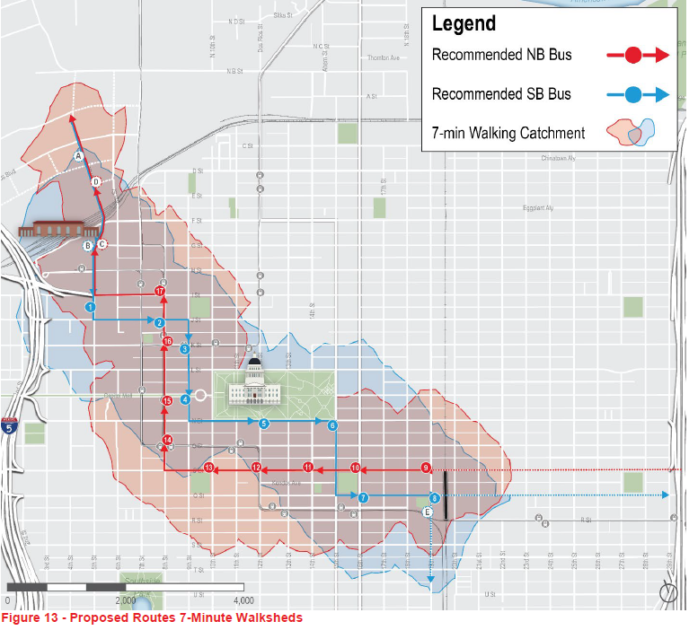
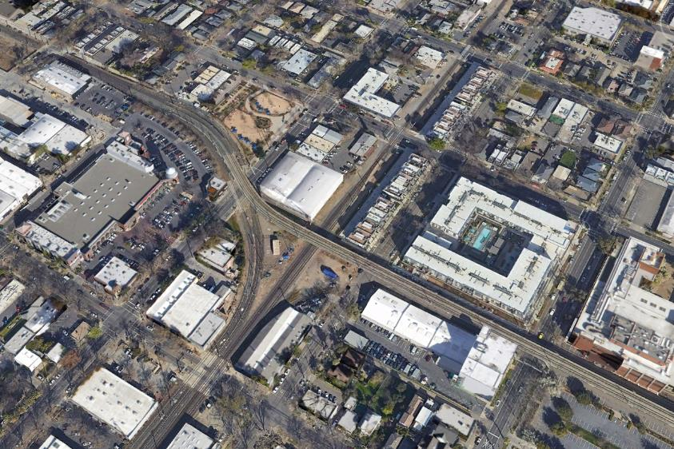
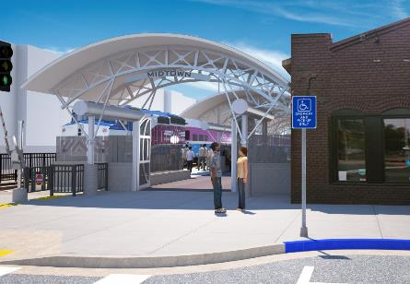
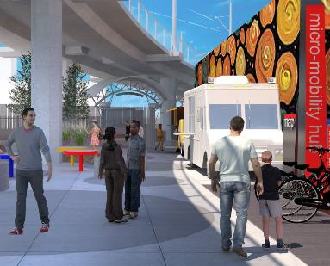
Sacramento Transportation Authority ITOC Meeting
February 29, 2024

Slide 34
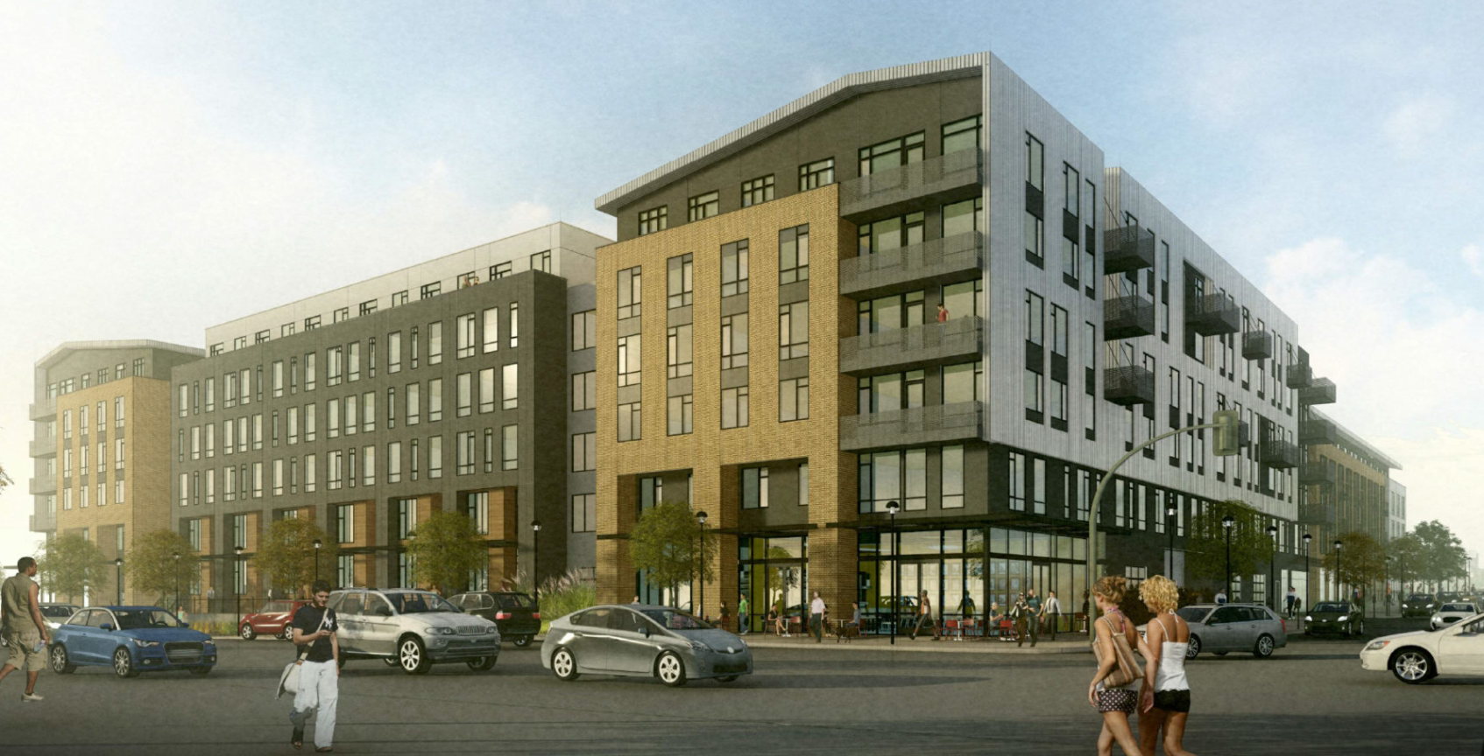
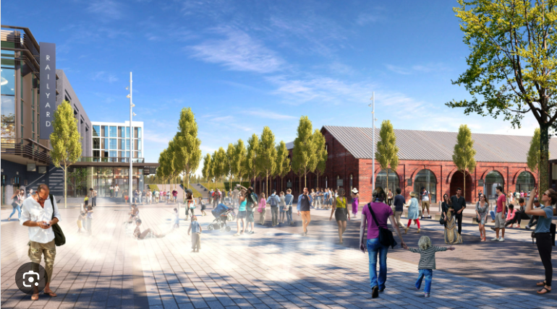
The AJ – 345 units. Completion Summer 2023
Central Shops Plaza/Live Nation.
Completion Spring 2025
Sacramento Transportation Authority ITOC Meeting
February 29, 2024

Slide 35
#7
SVS REGIONAL COMMUTER BUS STOPS
5TH STREET CONNECTOR
Sacramento Transportation Authority ITOC Meeting
February 29, 2024

Slide 36


RICHARDS / I-5 INTERCHANGE
FUTURE 5TH STREET EXTENSION
CONNECTION FROM RAILYARDS TO NORTH B STREET NEEDED TO ACCESS FREEWAY
Sacramento Transportation Authority ITOC Meeting
February 29, 2024

Slide 37
#8
REGIONAL COMMUTER BUS LAYOVER & EV CHARGING
Sacramento Transportation Authority ITOC Meeting
February 29, 2024

Slide 38

Downtown Sac Commuter Bus Layover/EV Charging
EPA Grant: Climate Pollution Reduction Grant
Sacramento Transportation Authority ITOC Meeting
February 29, 2024

Slide 39



Sacramento Transportation Authority ITOC Meeting
February 29, 2024

Slide 40
Sacramento Transportation Authority ITOC Meeting
February 29, 2024

Slide 41

Governance & Operations
2024 - 2026
Sacramento Transportation Authority ITOC Meeting
Steelblue for City of Sacramento/Perkins & Will
February 29, 2024

Slide 42

WHY?
SVS Governance & Operations
No additional capital money in the Measure A Expenditure Plan to leverage
City can’t continue to operate & maintain with City local funding alone –this is a regional facility
There is no other municipality that owns and operates a station of this intensity
City does not have direct access to transit & rail funds for expansion and operations
Sacramento Transportation Authority ITOC Meeting
February 29, 2024

Slide 43
GOALS
SVS Governance & Operations
Goal 1: Ensure the SVS fulfills its purpose as a regional transportation hub and district.
Goal 2: Implement a governance structure that sustains the existing facility and supports growth of regional rail and bus services, expansions, and modifications to the facility as necessary.
Goal 3: Establish a funding structure for the SVS that supports continued expansion, management, and operations of the SVS property.
Sacramento Transportation Authority ITOC Meeting
February 29, 2024

Slide 44
PROCESS
SVS Governance & Operations
RFP Two-Stage Process
  Decision point at end of Stage 1 to proceed/not to proceed
  Stage 1 – Identification
  Stage 2 – Implementation
Agency Outreach & Communication– critical element to success
Funding & Revenue Identification
Legal Structures Options
Sacramento Transportation Authority ITOC Meeting
February 29, 2024

Slide 45
Questions
Sacramento Transportation Authority ITOC Meeting
February 29, 2024

