Slide 1
Fiscal Year 2023-24 Budget Presentation
April 20, 2023
Dustin Purinton, CPA Accounting Manager

Slide 2
Summary
The law requires the Authority adopts an annual budget.
Open Items
Approval will happen at the June 2023 meeting.
The Appropriation Limit will not be released until after this meeting.
Draft budget was reviewed by the ITOC during the April 2023 meeting.

Slide 3
Policy / Budget Changes
STA will contribute the 5 Year Amortization amount for the Unfunded Accrued Liability (UAL).
Capital Improvement Program
New table to show the Smart Growth Improvement Program allocations.
Approximately $210,000 in savings over the new payment term.
Retirement Plan Funding Policy
Budget Resolution
Staff level budget appropriation amendment limit of $50,000 per fund.
Staff level sales tax revenue and related ongoing allocation appropriation amendment.

Slide 4
Consolidated Revenue

Slide 5
Consolidated Appropriations

Slide 6
SCTMFP
Sacramento Countywide Transportation Mitigation Fee Program (SCTMFP)
Included in the Capital Improvement Program Appropriations in the Consolidated Budget.
Currently preparing an updated Nexus study for the program.
Revenues and appropriations have no material changes.

Slide 7
Freeway Service Patrol
Appropriations are consistent with prior year.
The State Allocation Revenue is lower in the current year, staff are budgeting reasonably reimbursable amounts.

Slide 8
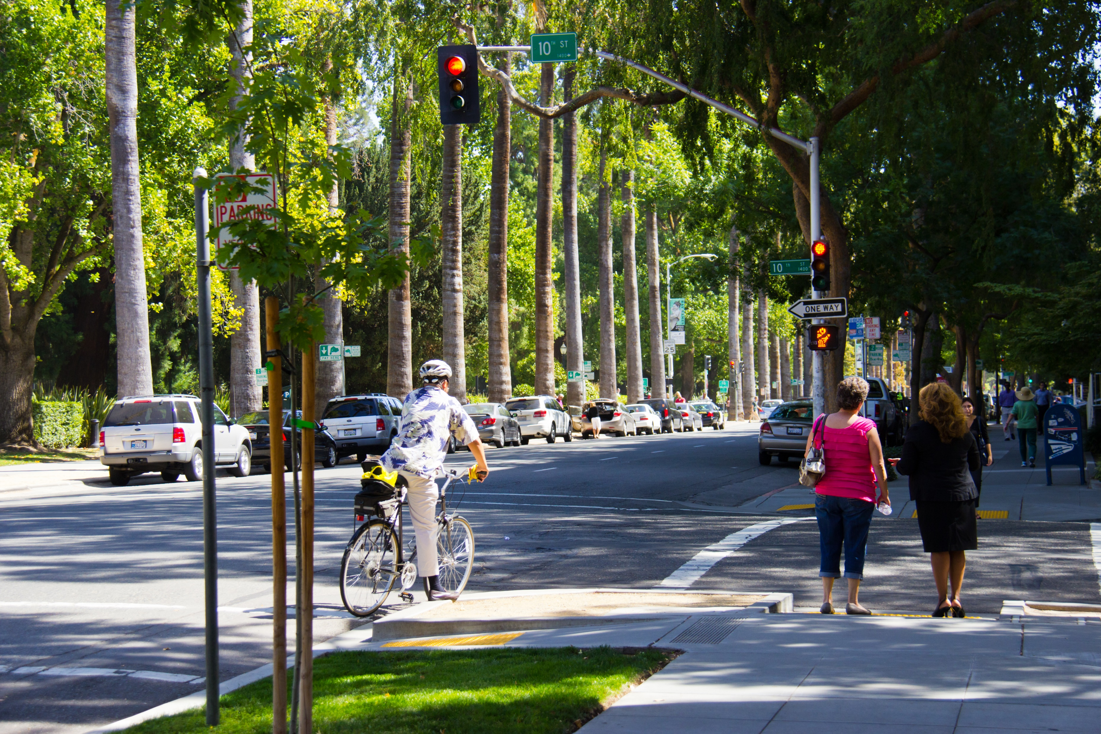
Administration
Revenues are expected to be consistent with the previous period.
Appropriations include an increase of $627,000 in Professional Services, this is due to anticipated additional outreach services, planning studies and a $515,000 expense for the 2022 election printing cost of the citizens’ initiative per the election code.
Salaries and benefits will increase $55,000 due to the change in the Unfunded Accrued Liability (UAL) funding policy.
Notes:
Mention fund balance is adequate to handle this.

Slide 9
Sacramento Abandoned Vehicle Service Authority
Revenues are anticipated to increase in the budget year due to the expectation that the California State legislation will pass AB 333 or the issuance of a new legal opinion.
Appropriations are anticipated to increase in proportion to the rising revenue.

Slide 10
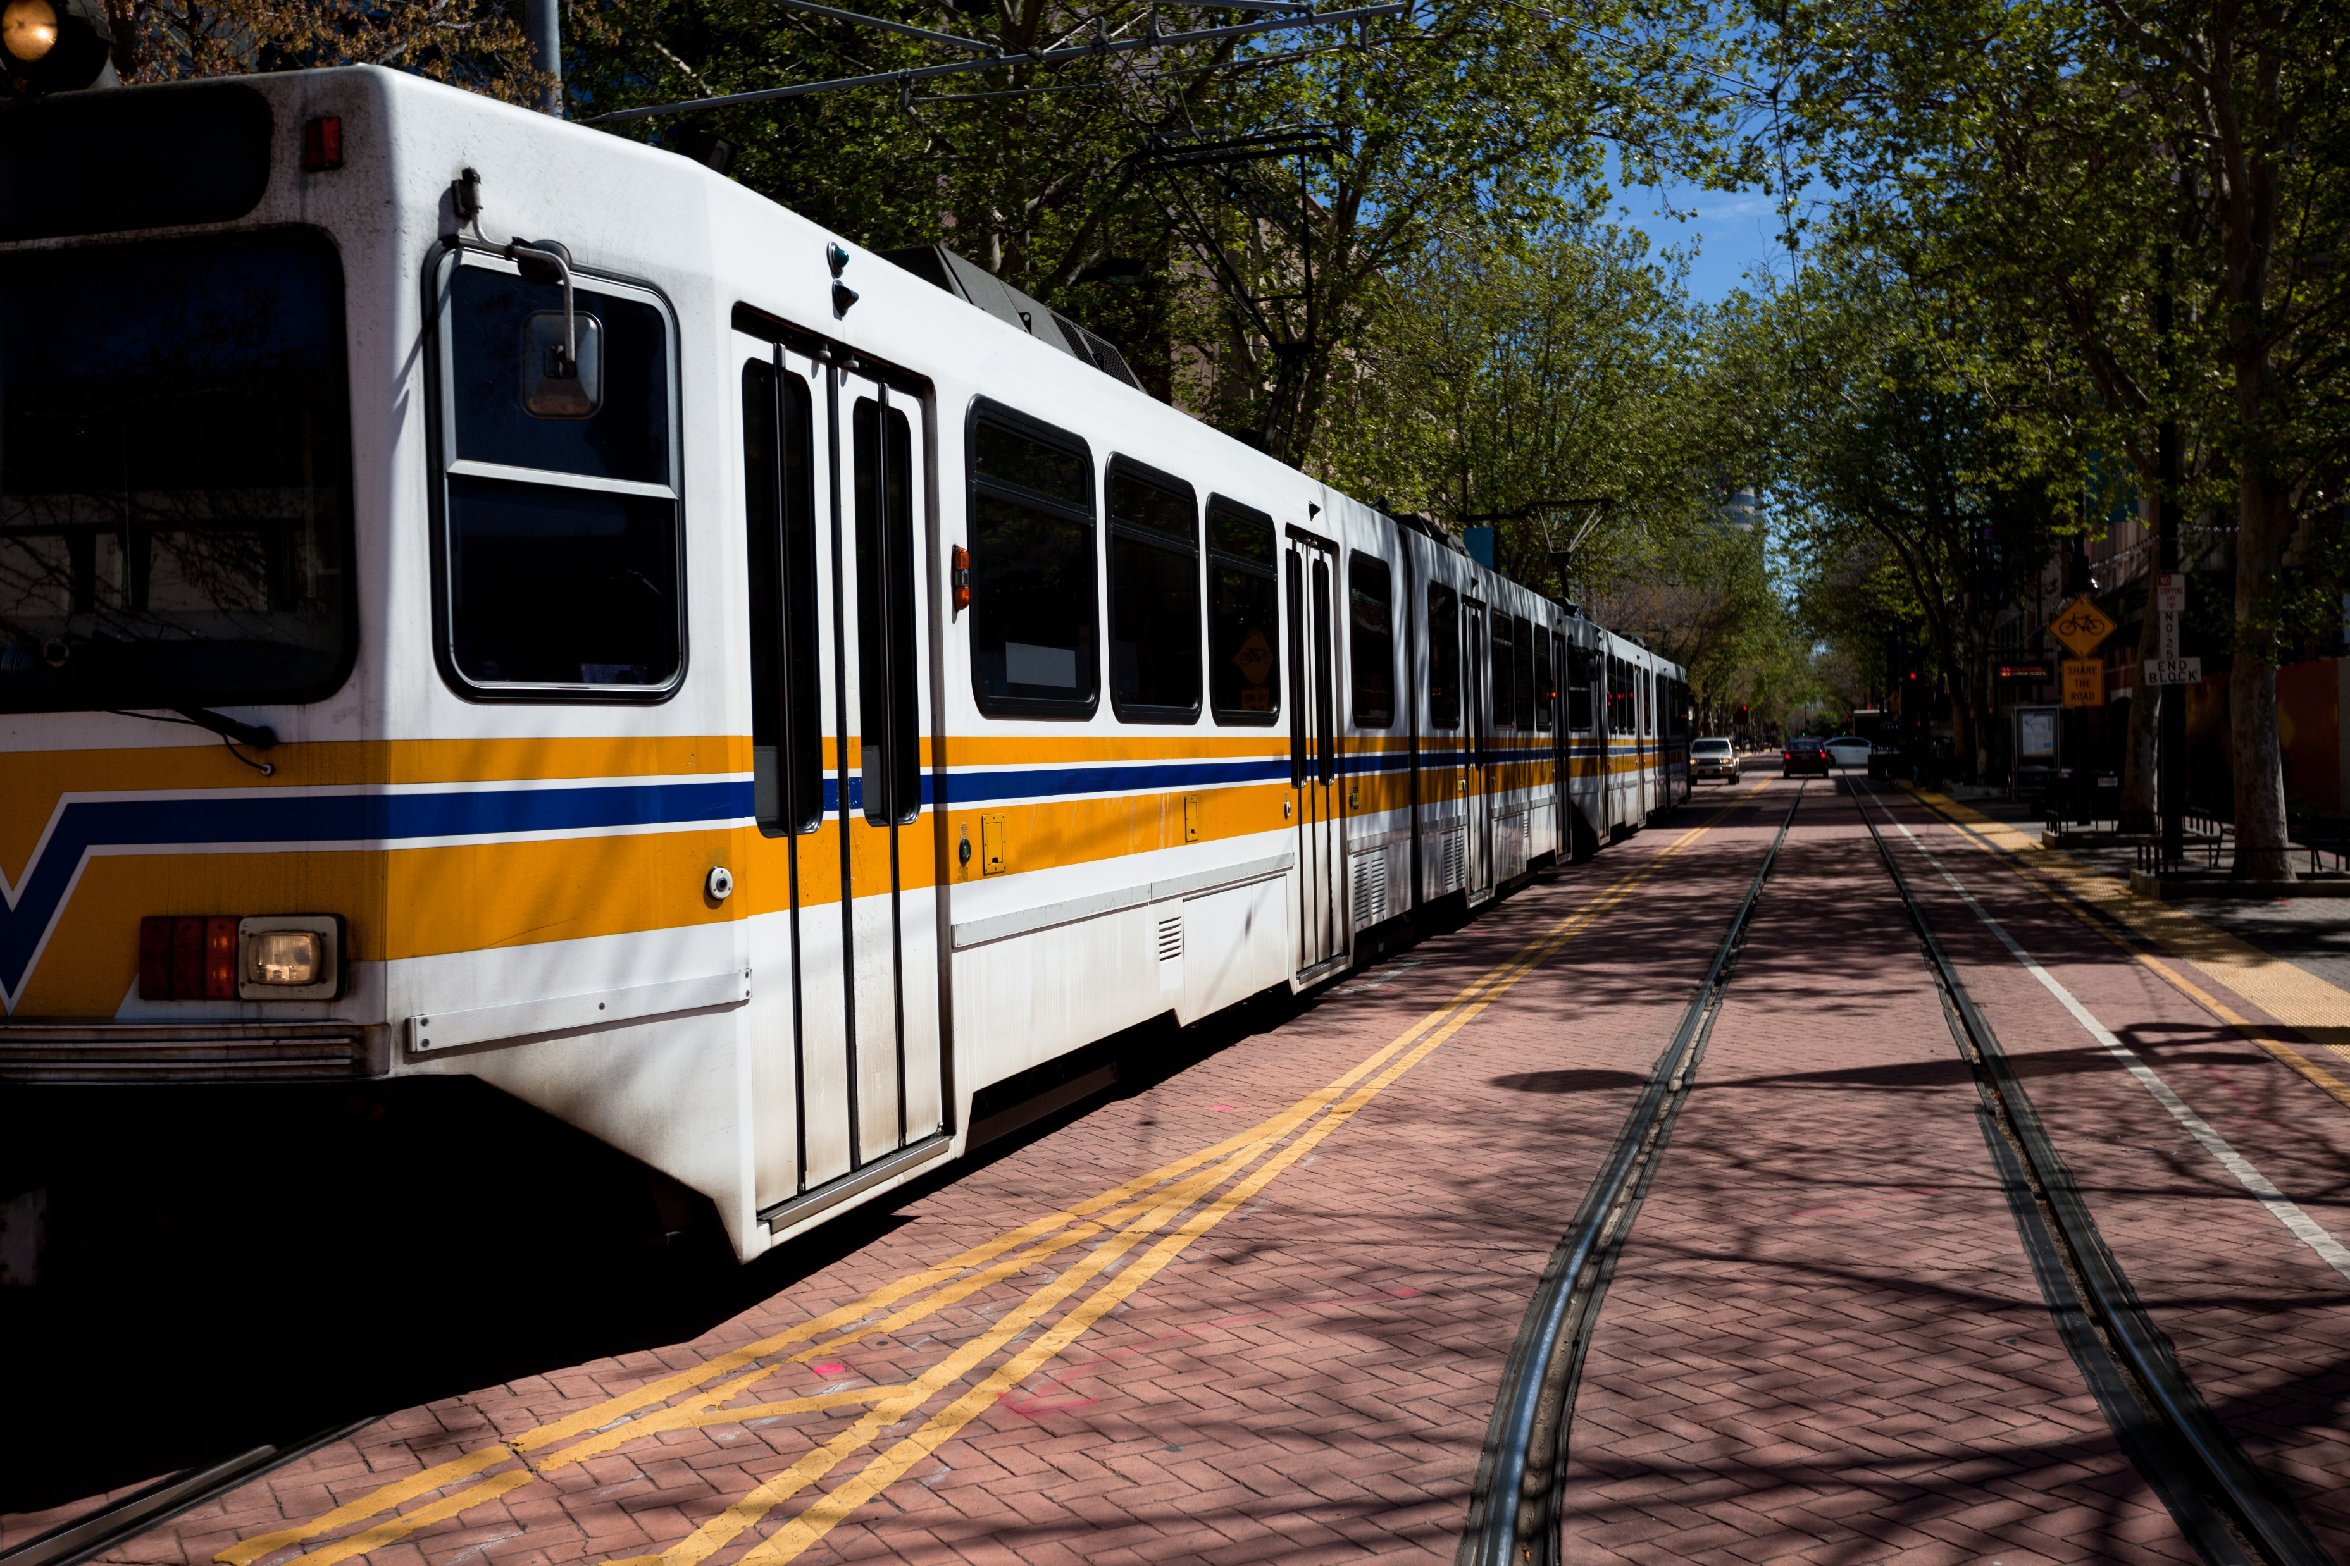
Transit Services
The Transit Services fund balance is being spent down as the Consolidated Transportation Services Agency (CTSA) spends down the fund balance.
The CTSA program collected and reserved 1% of its Measure Allocation in the first Decennial. On December 10, 2020, the Board began contracting the funds out for eligible programs.

Slide 11
Capital Improvement Program
Jurisdiction and Project Name | Amount | Jurisdiction and Project Name | Amount
California Department of Transporation: | 10,774,940 | County of Sacramento: | 12,373,000
I-5 Carpool Lanes US 50 - I-80 | 7,274,940 | Bradshaw at Jackson Rd. | 334,000
Hwy 50 HOV | 3,500,000 | Folsom Blvd. | 297,000
Capital SouthEast Connector JPA: | 6,700,000 | Greenback Lane Phase 1 | 1,782,000
Capital SouthEast Connector JPA | 2,700,000 | Greenback Lane Phase 2 | -
Grant Line Road | 4,000,000 | Hazel Ave. Phase 1 | -
City of Sacramento: | 2,169,288 | Hazel Ave. 50 to Folsom | 4,895,000
Intermodal | 400,000 | Madison Ave. Phase 1 | 1,276,000
Intermodal - Governance | 500,000 | South Watt Phase 1 | 2,694,000
Richards/I-5 | 400,000 | Sunrise - Jackson to Grant Line | 330,000
Broadway Complete Streets | 619,288 | Watt Ave. - Antelope to Cap City | 27,000
Envision Broadway In Oak Park | 200,000 | Greenback Lane Complete Streets | 400,000
Stockton Blvd. Complete Street | 50,000 | Arden Way Complete Streets | 338,000
Sacramento Regional Transit District: | 354,000 | City of Galt: | 45,000
Sacramento Valley Station Loop | 354,000 | Kost Road Improvements | 45,000
 |  | City of Rancho Cordova: | 484,670
 |  | Chase Drive - American River Parkway Connect | 484,670

Slide 12
Questions?
This item is for informational purposes only. It will be continued in the June Board Meeting.

